Slide 1
The Flip project
Morning Math Time
Ted Hodgson, Mike Waters
Department of Mathematics
Northern Kentucky University
hodgsont1@nku.edu

Slide 2
The FLIP Quote of the Day
Flipping the classroom is not the answer to solving all of the problems in our education system. However, neither is doing nothing and continuing on like nothing can be improved.
- Brett Clark

Slide 3
The Problem of Points
Two equally skilled players, F and P, are interrupted while playing a game of chance. If the game had not been interrupted, the first person to score 10 points would be declared the winner and receive the winning prize of $100. At the time of the interruption, F is leading by a score of 8 to 7. Given the score of the game at the point of interruption, what is a fair distribution of the $100?

Slide 4
The FLIP Quote of the Day
Many people think the flipped class is all about the technology. In fact, this is not correct. It is about changing the pedagogy with the aid of technology.
- Jonathan Bergman, An “Original” Flipper

Slide 5
Pesky Math
To Divide a Triangle into Thirds
Divide the base into thirds
Construct segments from each division of the base to the opposite vertex.

Slide 6
Pesky Method
To Divide a Triangle into Thirds
Divide the base half
Divide each adjacent side into thirds
Construct segments from the midpoint of the base to the “opposite third” of each adjacent leg
Since ½ * 2/3 = 1/3, Pesky claims the method works.

Slide 7

Our Morning Math Recipe
Start with one cup (8 oz) of coffee and one cup of cup of cream.
Add one teaspoon of the cream to the cup of coffee and mix thoroughly.
Then, remove one teaspoon from the coffee/cream mixture and add to the cream. Mix thoroughly.
Is there more coffee in the cream, or cream in the coffee?

Slide 8
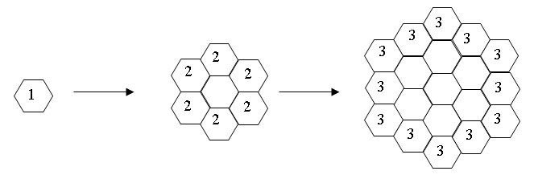
Busy Bees
Bees build their nests in hexagonal cells. Assume they begin by building a single cell and expand outward in stages, numbered below in the diagram.

Slide 9
How many cells are built at the 4th stage? How many cells total have been built by the 4th stage?
How many cells are built at the 10th stage? How many cells total have been built by the 10th stage?
How many cells are built at the n^{th} stage? How many cells total have been built by the n^{th} stage?
Describe the pattern you found in part 3 by characterizing the relationship between the stage number and the number of cells built at that stage. Can you explain this relationship? How does this relationship compare to the total number of cells that have been built?

Slide 10
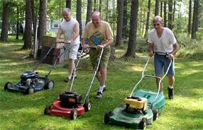
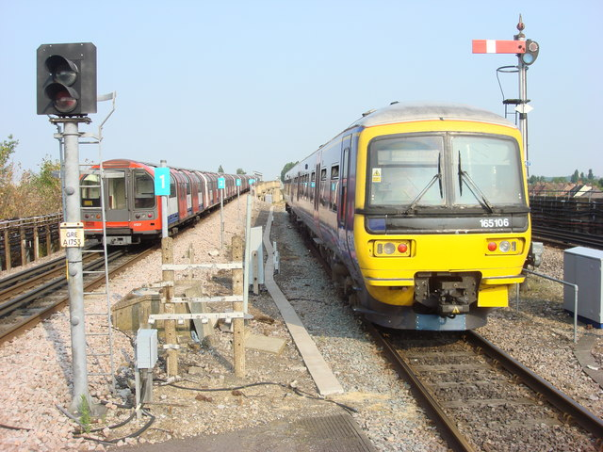
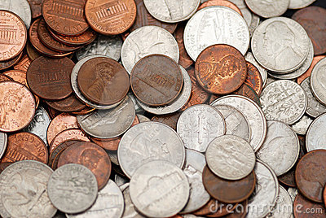

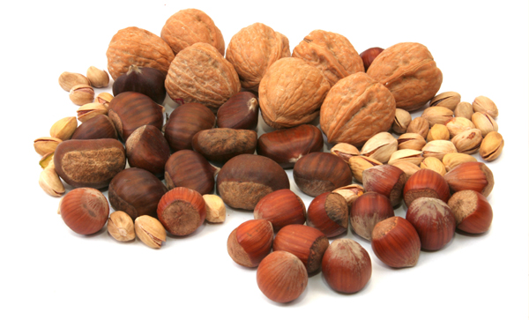
Algebra Classics

Slide 11

Translate the following sentence into “mathematics”
There are five times as many teachers as professors at the FLIP workshop.

Slide 12
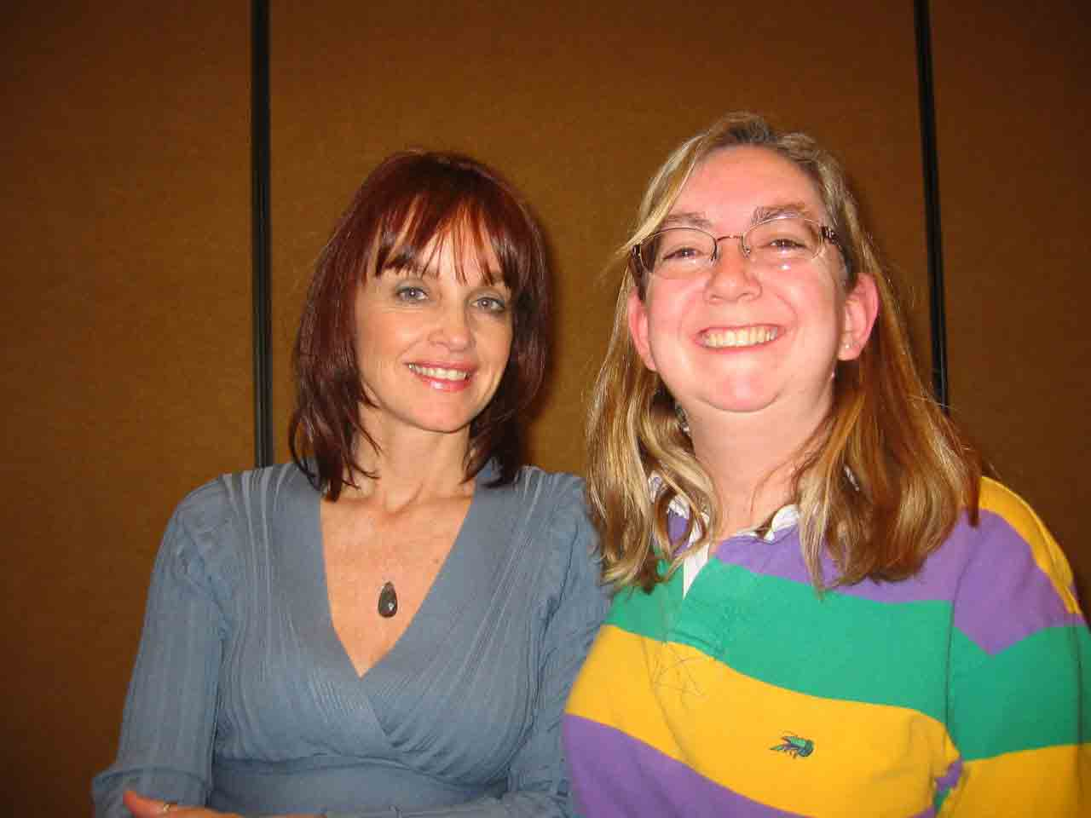
The sum of the ages of Sally and Sue is 44. Five years ago, the ratio of Sally’s age to Sue’s age was 39 to 49.
How old are Sally and Sue?

Slide 13
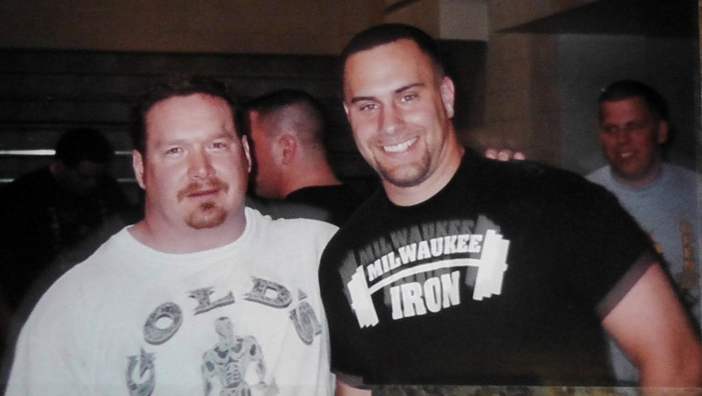
The sum of the ages of Mike and Ed is 44.
Mike is twice as old as Ed was when Mike was half as old as Ed will be when Ed is three times as old as Mike was when Mike was three times as old as Ed.
How old are Mike and Ed?

Slide 14
FRED SEIDENBERG’S SPECIAL
A man twice as old as his sister weighs 10 pounds more that his cousin and has 12 more dimes than quarters in his pocket. He rows 5 miles upstream to get to candy store. When he left, a plane left for New York flying against a head wind of 15 mph. He uses money to buy mixed nuts, of which 10% are cashews. How soon after the trains meet does he arrive at the store? What are the dimensions of the store?

