Slide 1
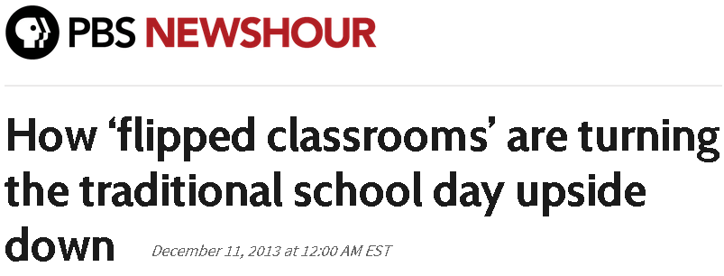
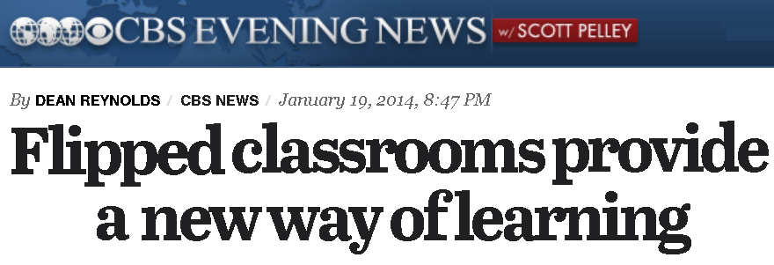
Flipping the Classroom: A Brief Overview

Slide 2
The FLIP Quote of the Day
“Ultimately, flipped learning is not about flipping the 'when and where' instruction is delivered; it's about flipping the attention away from the teacher and toward the learner.”
- Brian Bennett

Slide 3
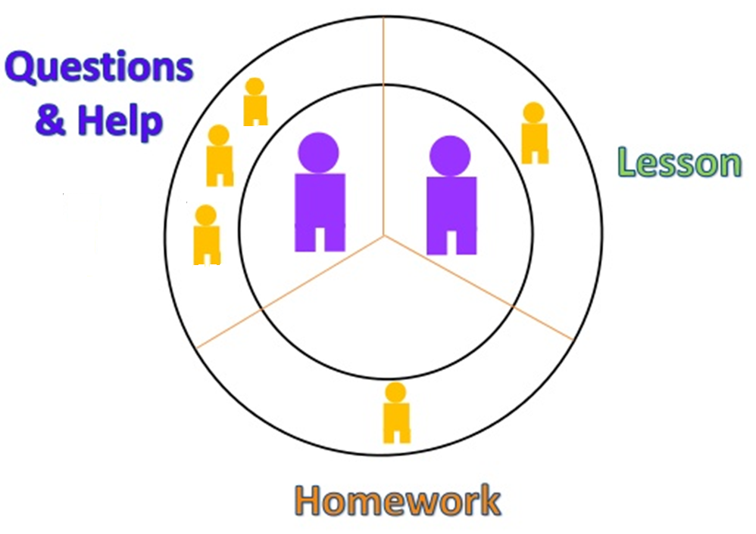
The Traditional Mathematics Classroom

Slide 7
Via the Flipped Classroom
Teachers can shift the Outer Circle

