Slide 1
Using Lagrange interpolation polynomial to estimate polynomial regression.
By Stefanie Russell

Slide 2
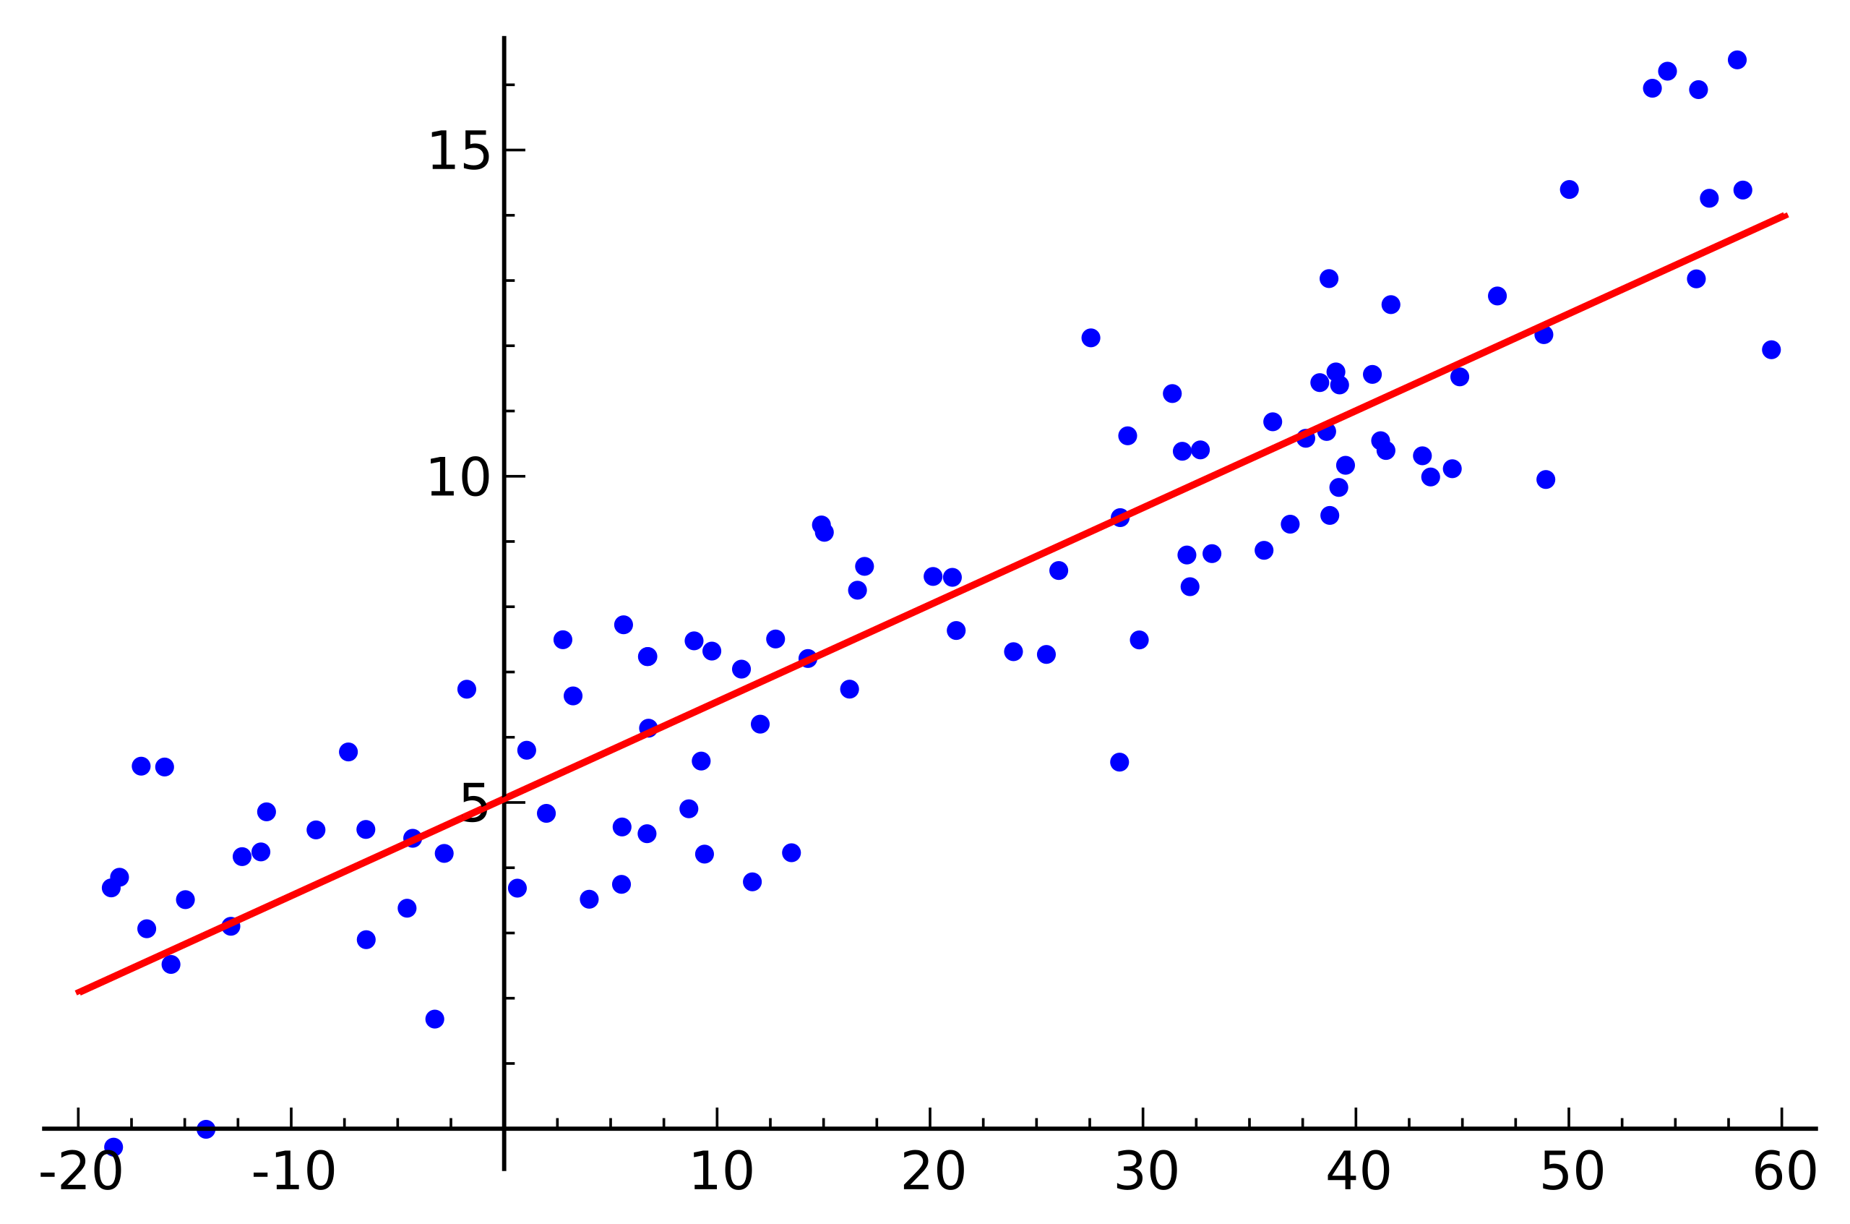
Simple Linear regression
In linear regression they use a equation to fit a best suited line to the data that was recorded.
Y=β₀ +β₁x

Slide 3
Simple linear regression
At times a straight line is not suitable for the data given so a quadratic piece needs to be introduced
β₀ +β₁x+β₂ x²

Slide 4
The Code
I used octave to create a code that would create all the possible quadratic Lagrange polynomials. Then the code would take the average of the all the polynomials and produce a best guess for the prediction of the data.

Slide 5
The data I used
This is data set taken from online. They were measuring the yield they were producing at five different temperatures.

Slide 6
The graphs

Slide 7
Issues I had with the code
The first issue I came across was having Two or more of the X values the same but they had different Y values
This would produce Undefined areas in the lagrange formula and would then produce a response of Inf in octave.
I fixed this with putting a couple of while loops to find the first X2 that was not equal to X1 and then having to do the same for X2 and X3. I could not figure out how to stop this at the end when it reached X1=90. I did however put in a way to bypass this and still get the answer.

Slide 8
The Results
My code
Equation
X0=55 2.35
X0=65 2.2417
X0=75 2.3592
X0=85 2.7025
X0=95 3.2717
X0=100 3.6410
X0=55 2.7614
X0=65 2.5156
X0=75 2.4850
X0=85 2.6696
X0=95 3.0694
X0=100 3.35

Slide 9
Why sum of squares of error is better
y = a + bx + cx²,

Slide 10
Reference page
Papers with code - linear regression explained. Explained | Papers With Code. (n.d.). https://paperswithcode.com/method/linear-regression
Szczepanek, A. (2023, June 5). Quadratic regression calculator. Formula. https://www.omnicalculator.com/statistics/quadratic-regression#:~:text=Hence%2C%20if%20you%20still%20are%20wondering%20how%20to,equations%20calculator%20to%20read%20how%20to%20do%20this.
7.8 - polynomial regression examples. 7.8 - Polynomial Regression Examples | STAT 462. (n.d.). https://online.stat.psu.edu/stat462/node/159/

