Slide 1

Monte Carlo Integration
Madison Redman
MAT360 Project #2

Slide 2
History of Monte carlo methods
Developed and formalized by notable Math and Science figures Fermi, Ulam, von Neumann, Metropolis, and others
The Manhattan Project and the Atomic Bomb
Used to study the probabilistic behavior of neutron transport in fissile materials
Started in nuclear physics
Now used in many different disciplines
  Computational science
  Statistics
  Computer graphics
  Engineering

Slide 3
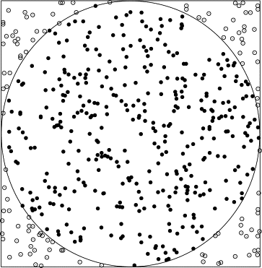
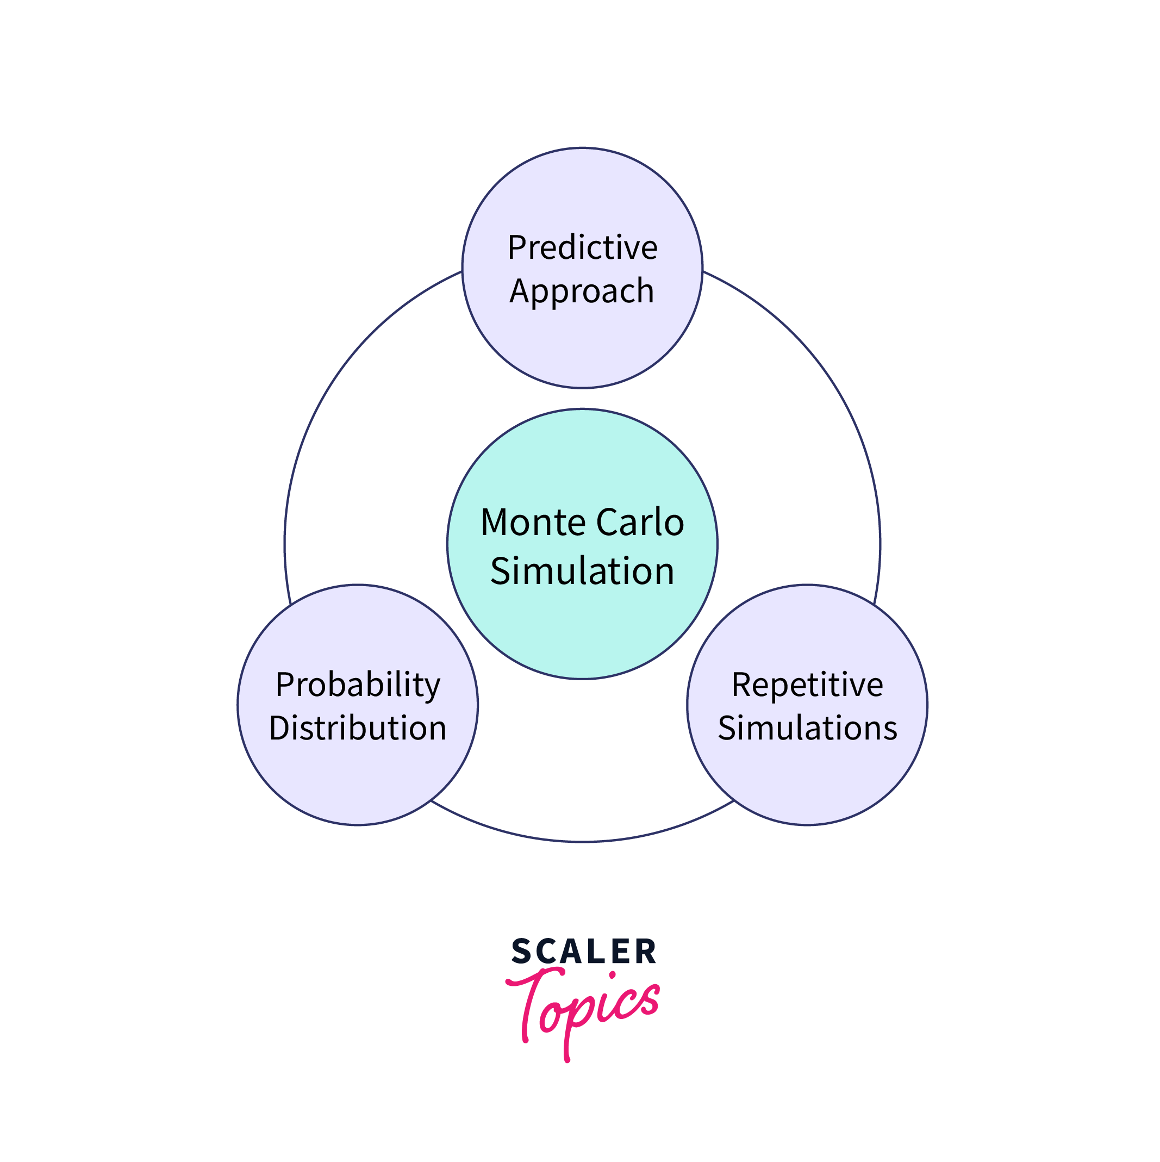
Overview of Monte carlo methods
Random or “stochastic” sampling
Law of Large Numbers
Monte Carlo Simulation
Hit or Miss Monte Carlo Method
Monte Carlo Integration
Technique of estimating or averaging using “random” samples

Slide 4
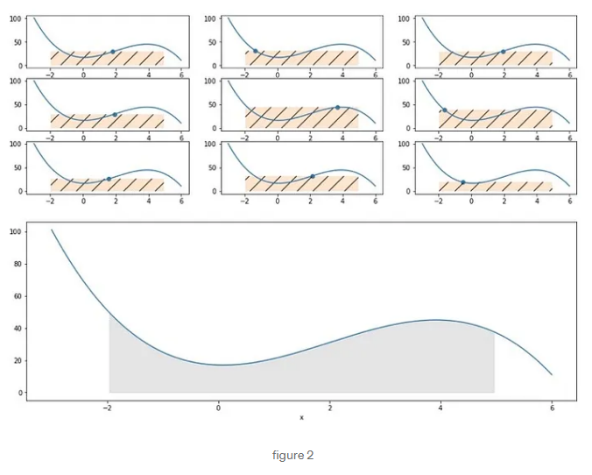
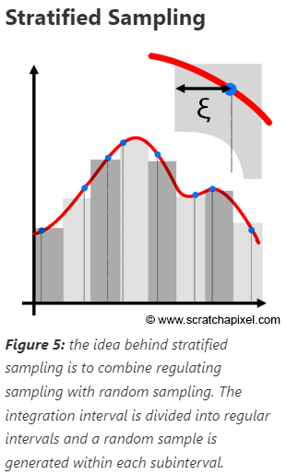

Specifically: crude Monte carlo Integration
$$\int_{a}^{b}{f(x)ⅆx≅\frac{b−a}{n}\sum_{i=0}^{n}{f(x_{i})}}$$
for some n = number of points (nodes)
And points are randomly selected using uniform distribution

Slide 5
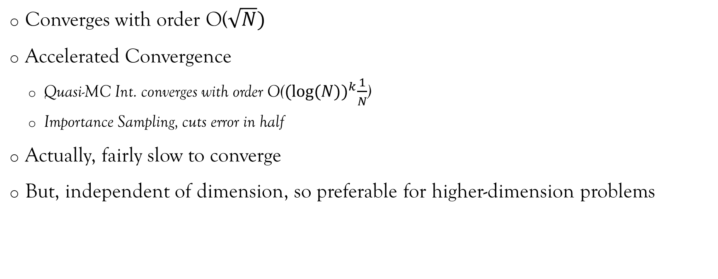
More on Mc integration
Converges with order O($\sqrt{N})$
Accelerated Convergence
  Quasi-MC Int. converges with order O(${(log⁡(N))}^{k}\frac{1}{N}$)
  Importance Sampling, cuts error in half
Actually, fairly slow to converge
But, independent of dimension, so preferable for higher-dimension problems

Slide 6
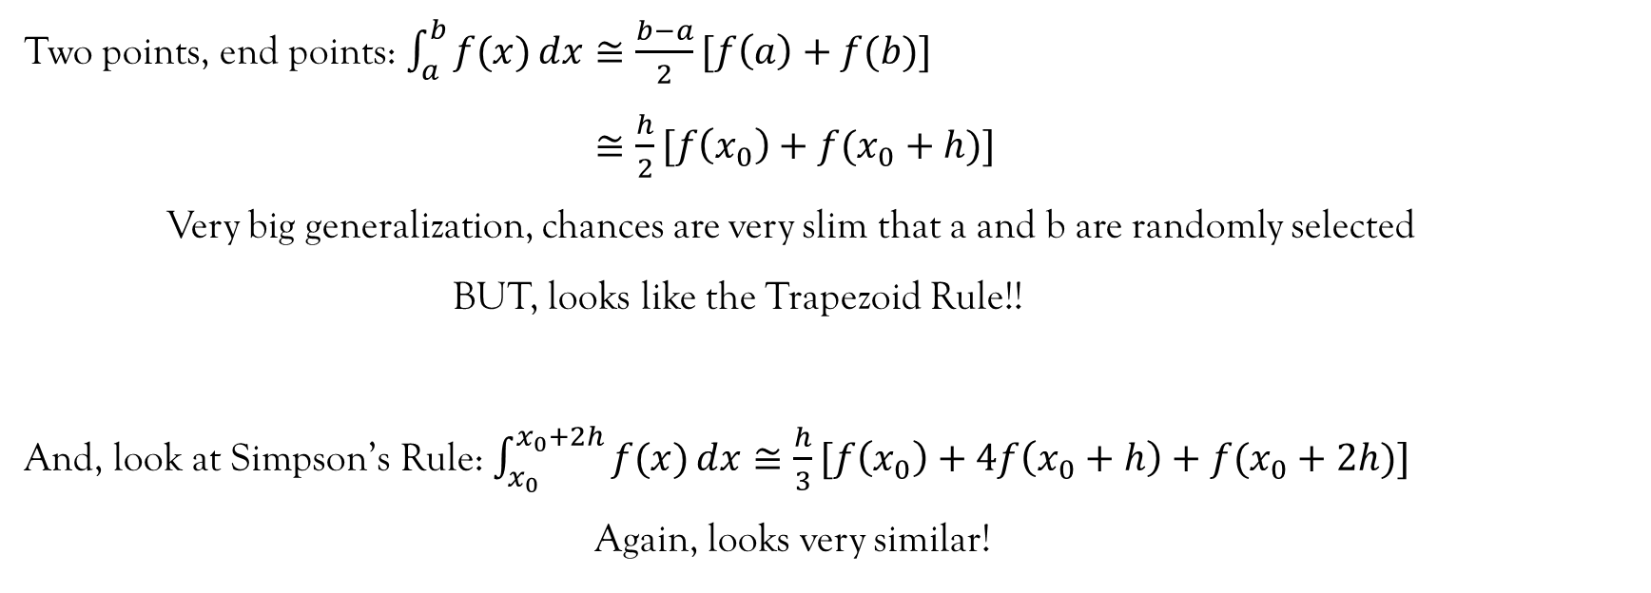
Interesting discoveries
Two points, end points: $\int_{a}^{b}{f(x)ⅆx≅\frac{b−a}{2}[f\left(a\right)+f(b)]}$
$≅\frac{h}{2}[f\left(x_{0}\right)+f(x_{0}+h)]$
Very big generalization, chances are very slim that a and b are randomly selected
BUT, looks like the Trapezoid Rule!!
And, look at Simpson’s Rule: $\int_{x_{0}}^{x_{0}+2h}{f(x)ⅆx≅\frac{h}{3}[f\left(x_{0}\right)+4f\left(x_{0}+h\right)+f(x_{0}+2h)]}$
Again, looks very similar!

Slide 7
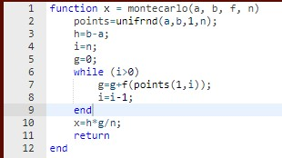
A little bit of code…
Uniform distribution function
Random Sampling
Different result each time

Slide 8
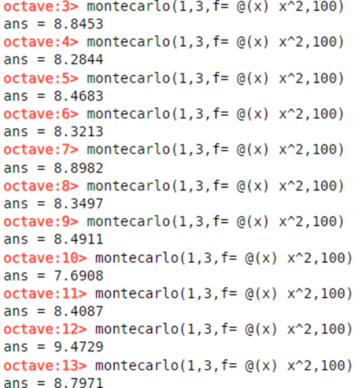
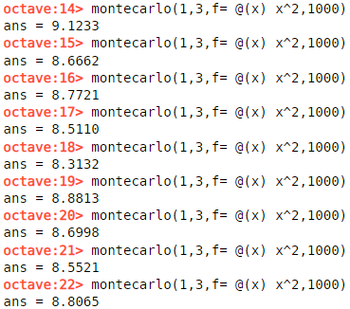
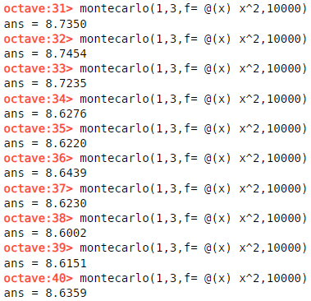
Let’s look at an example

Slide 9
An overlook on mc integration
So, very slow to converge…
BUT, preferable for high-dimension evaluations
Used in many different fields
Especially:
Computer graphics
Nuclear physics
Engineering

Slide 10
Bibliography
https://cs.dartmouth.edu/~wjarosz/publications/dissertation/appendixA.pdf
https://towardsdatascience.com/the-basics-of-monte-carlo-integration-5fe16b40482d
https://www.scratchapixel.com/lessons/mathematics-physics-for-computer-graphics/monte-carlo-methods-mathematical-foundations/quick-introduction-to-monte-carlo-methods.html
https://www.math.pku.edu.cn/teachers/litj/notes/numer_anal/MCQMC_Caflisch.pdf
https://towardsdatascience.com/the-basics-of-monte-carlo-integration-5fe16b40482d
https://docs.octave.org/v4.2.2/Random-Number-Generation.html

