Slide 1
Mathemalchemy Museum Opening Proposal
By: Sahira Warnsley

Slide 2
Public Relations
Company reputation
Influence
Public's view

Slide 3
Flier
Mathemalchemy Museum
GRAND
OPENING
Saturday, June 15, 2024
5:30 p.m. to 10:30 p.m.
647 West. 34th St, NY
SEE YOU THERE!
Dress code: Mathemalchemy inspired outfits/makeup

Slide 4
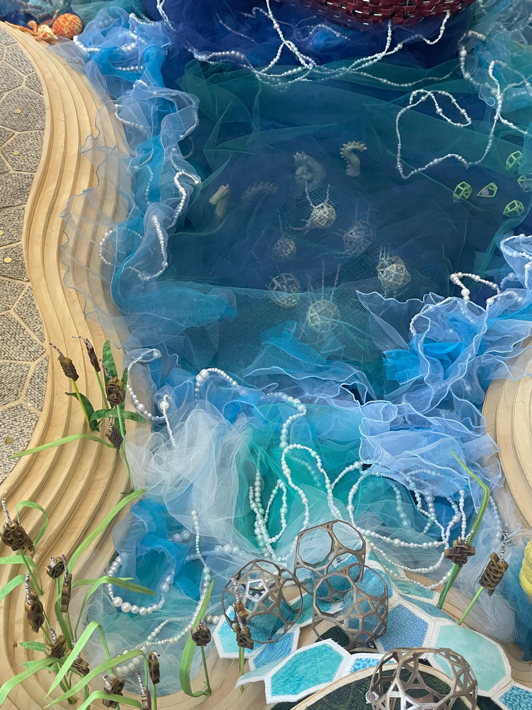
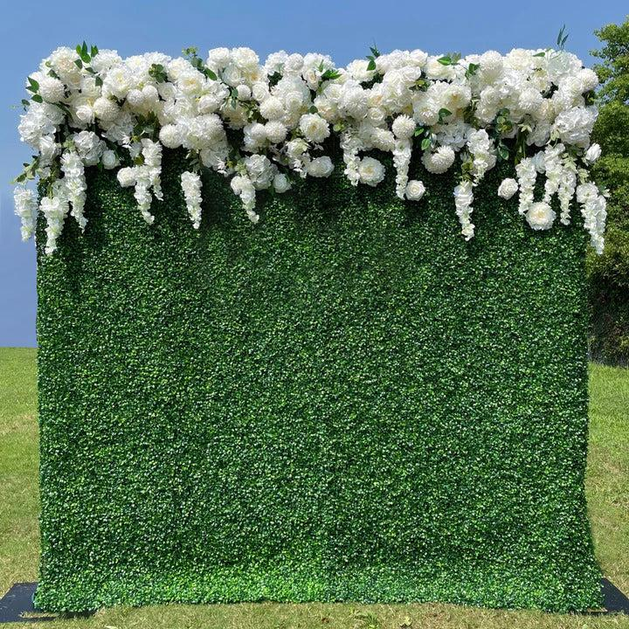
Make The Opening Fun
Photo Wall
Lining Wall Edges

Slide 5
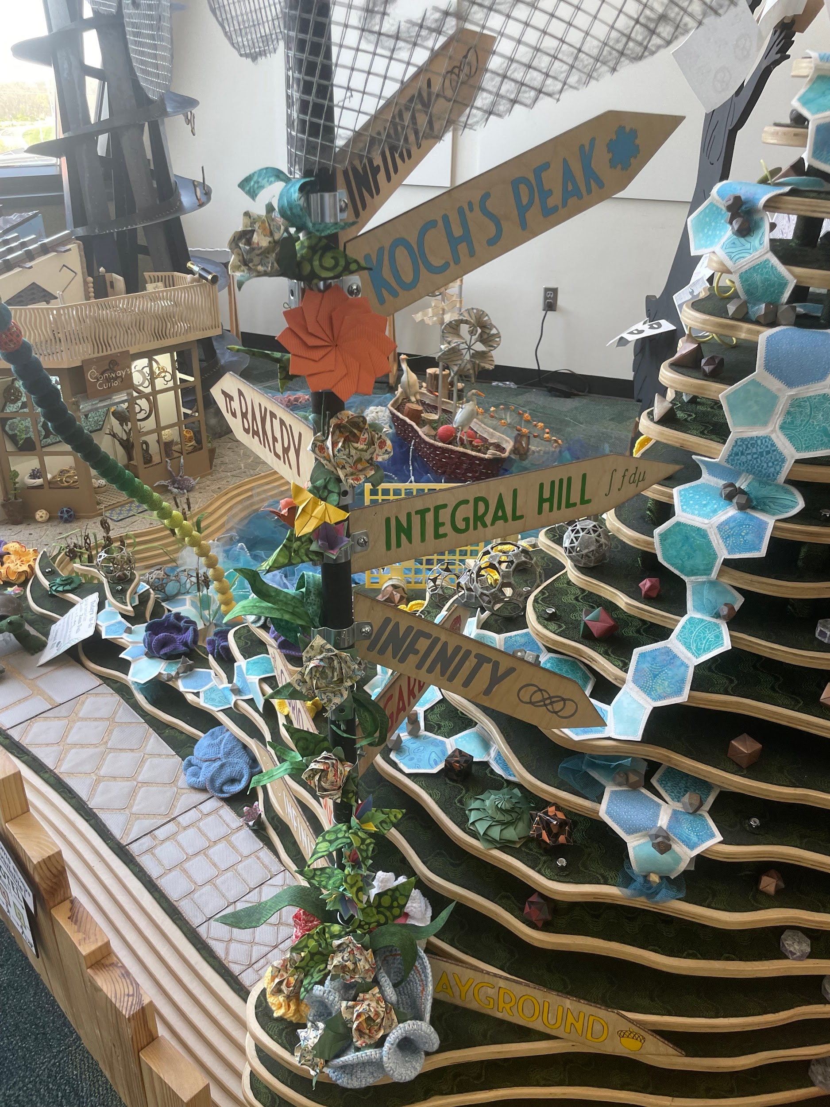
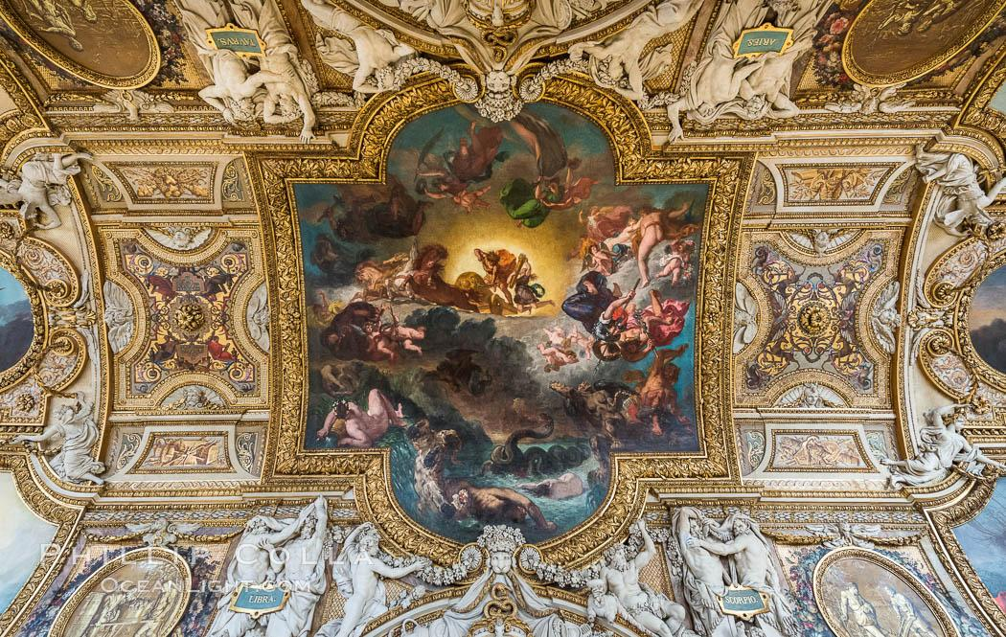
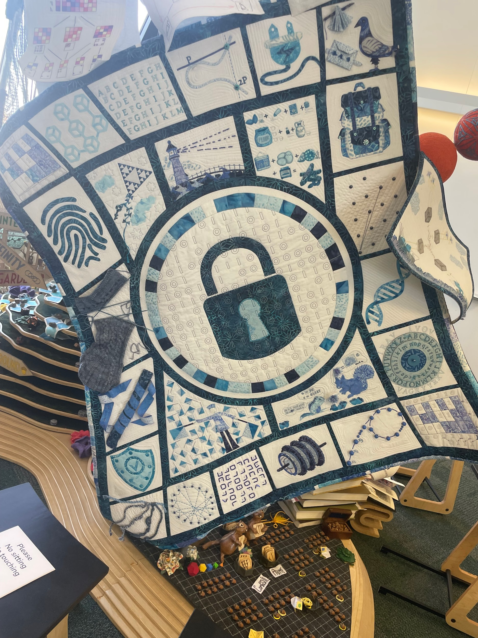
Decoration
Painter paint the quilt on the floor or Ceiling
Use signs to point directions

Slide 6
Attendees
Journalist
Videographers
Photographers
Celebrities
Artist

Slide 7
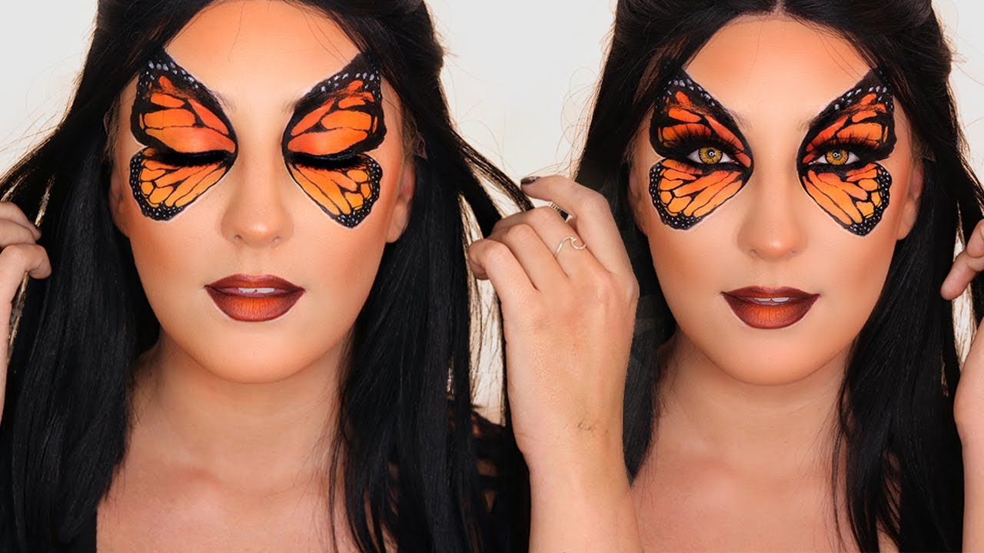
Mathemalchemy inspired makeup

Slide 8
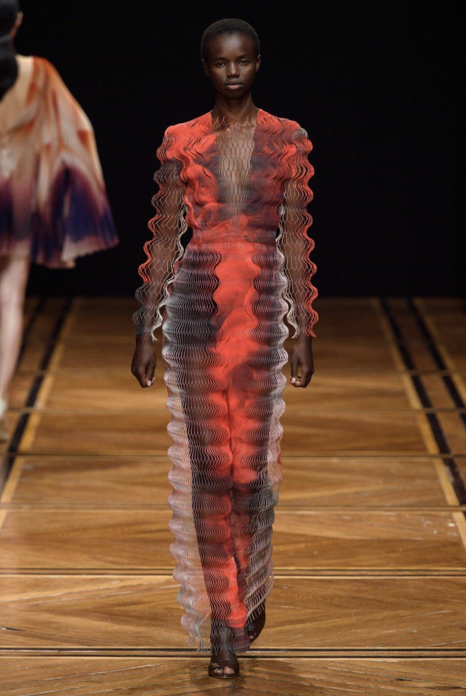
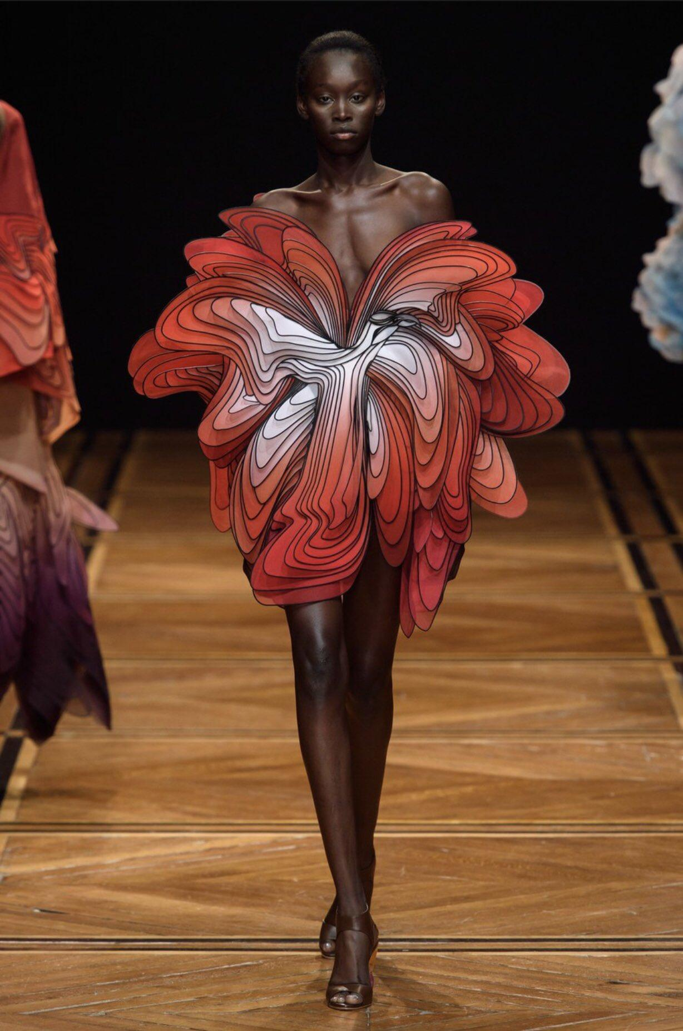
Mathemalchemy fashion

Slide 9
Public relations and Mathemalchemy
New Audience
Math can be fun
Supporters
Bigger budget

