Slide 1
Mathemalchemy Coffee Bar
At the Hilbert Hotel

Slide 2
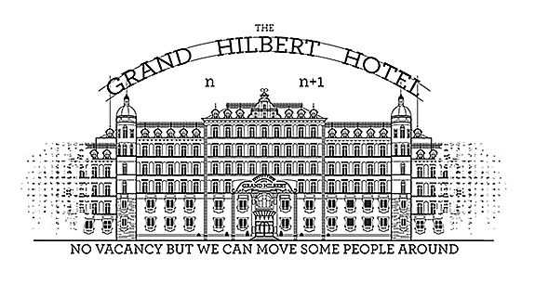
Introducing the Infinity Cafe!

Slide 3
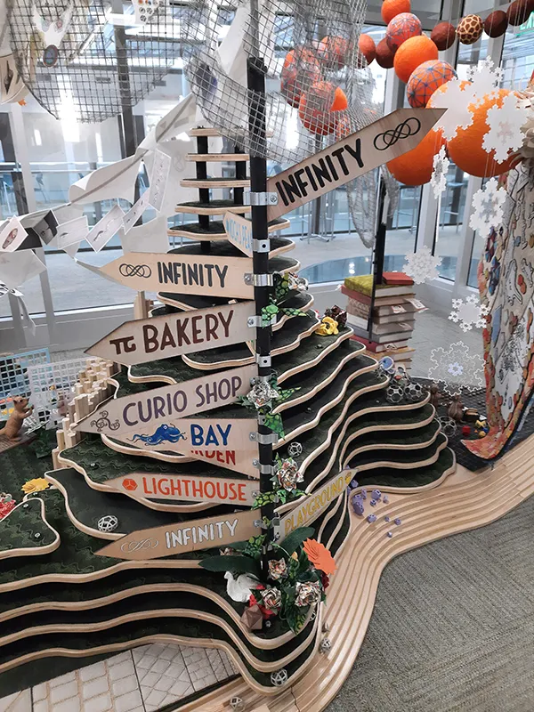
Inspirations…
The Bay
Tess the Tortoise
The Garden
The Squirrels
Knots
The Bakery
Fibonacci
Infinity (the name)

Slide 4
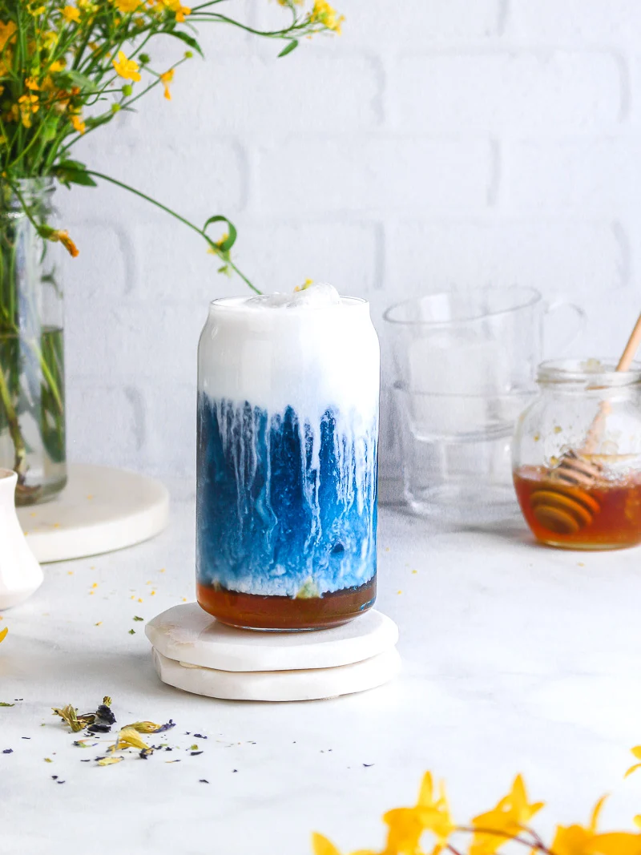
The Bay
Blue Butterfly Pea Flower Tea with Cold Foam

Slide 5
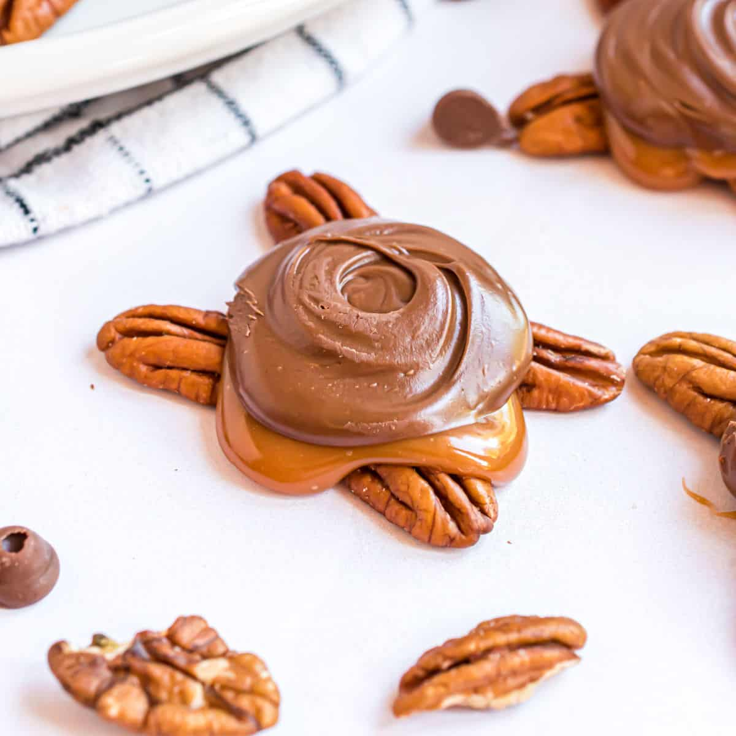
Tess the Tortoise
Turtle Delights

Slide 6
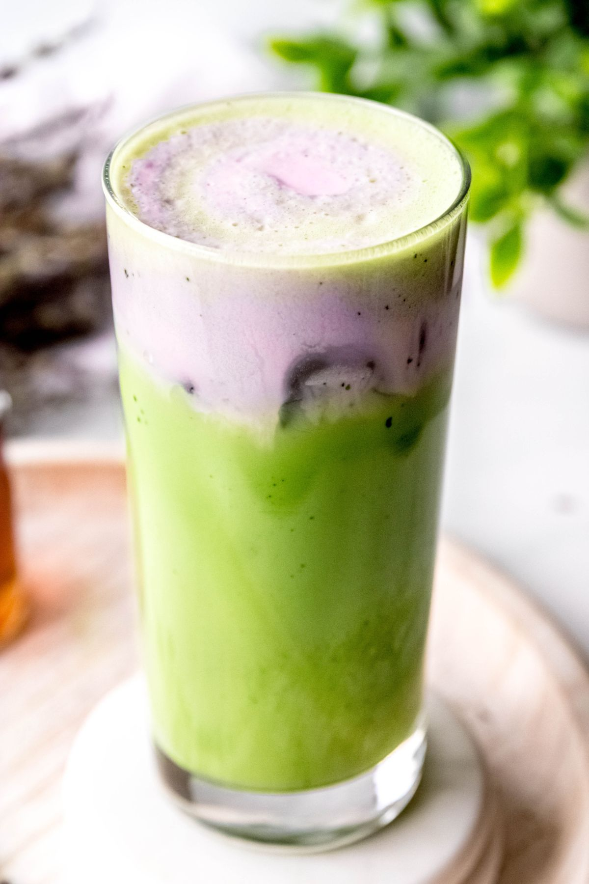
The Garden
Matcha Latte with Lavender

Slide 7
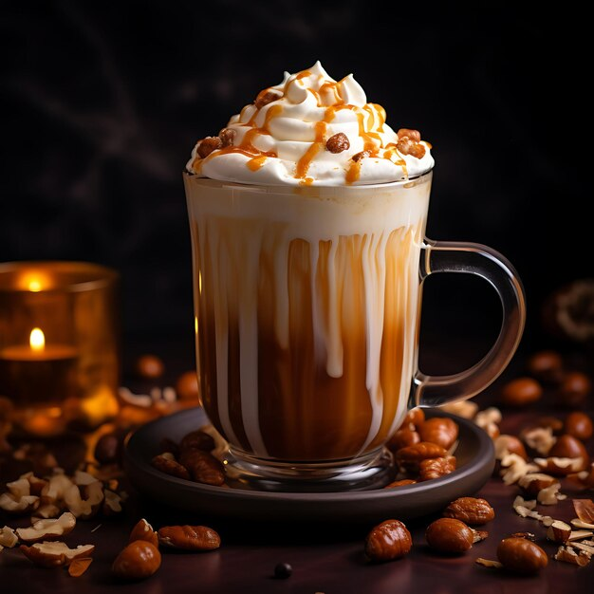
The Squirrels
Caramel Latte with Hazelnut

Slide 8
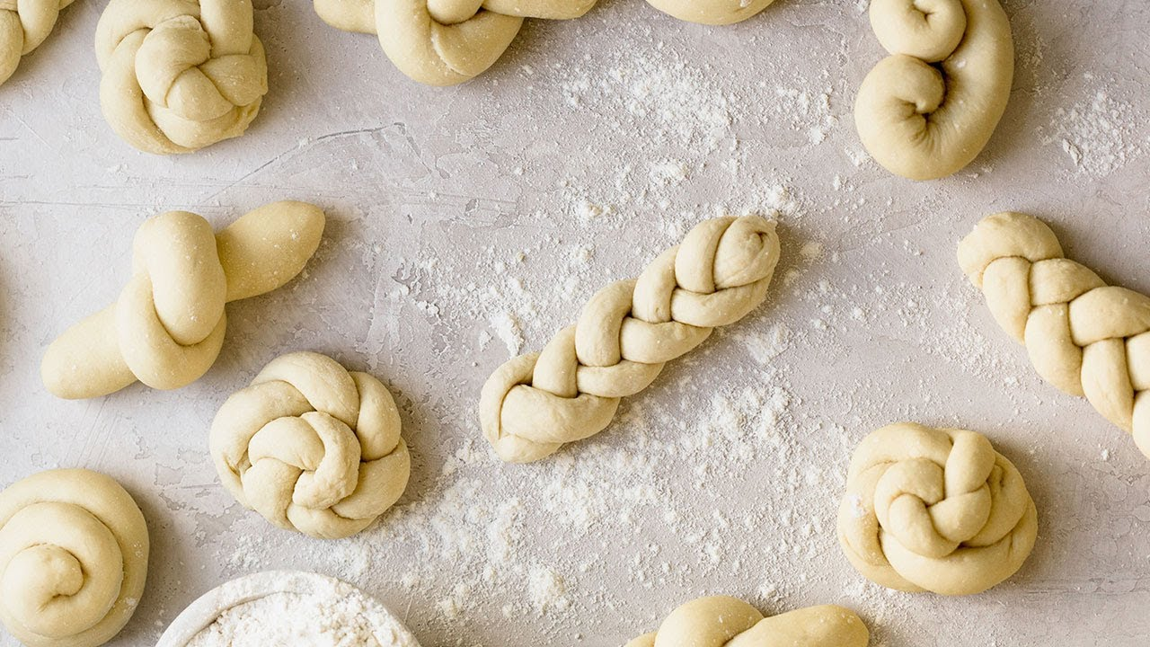
Knots
Pastries formed into knots

Slide 9
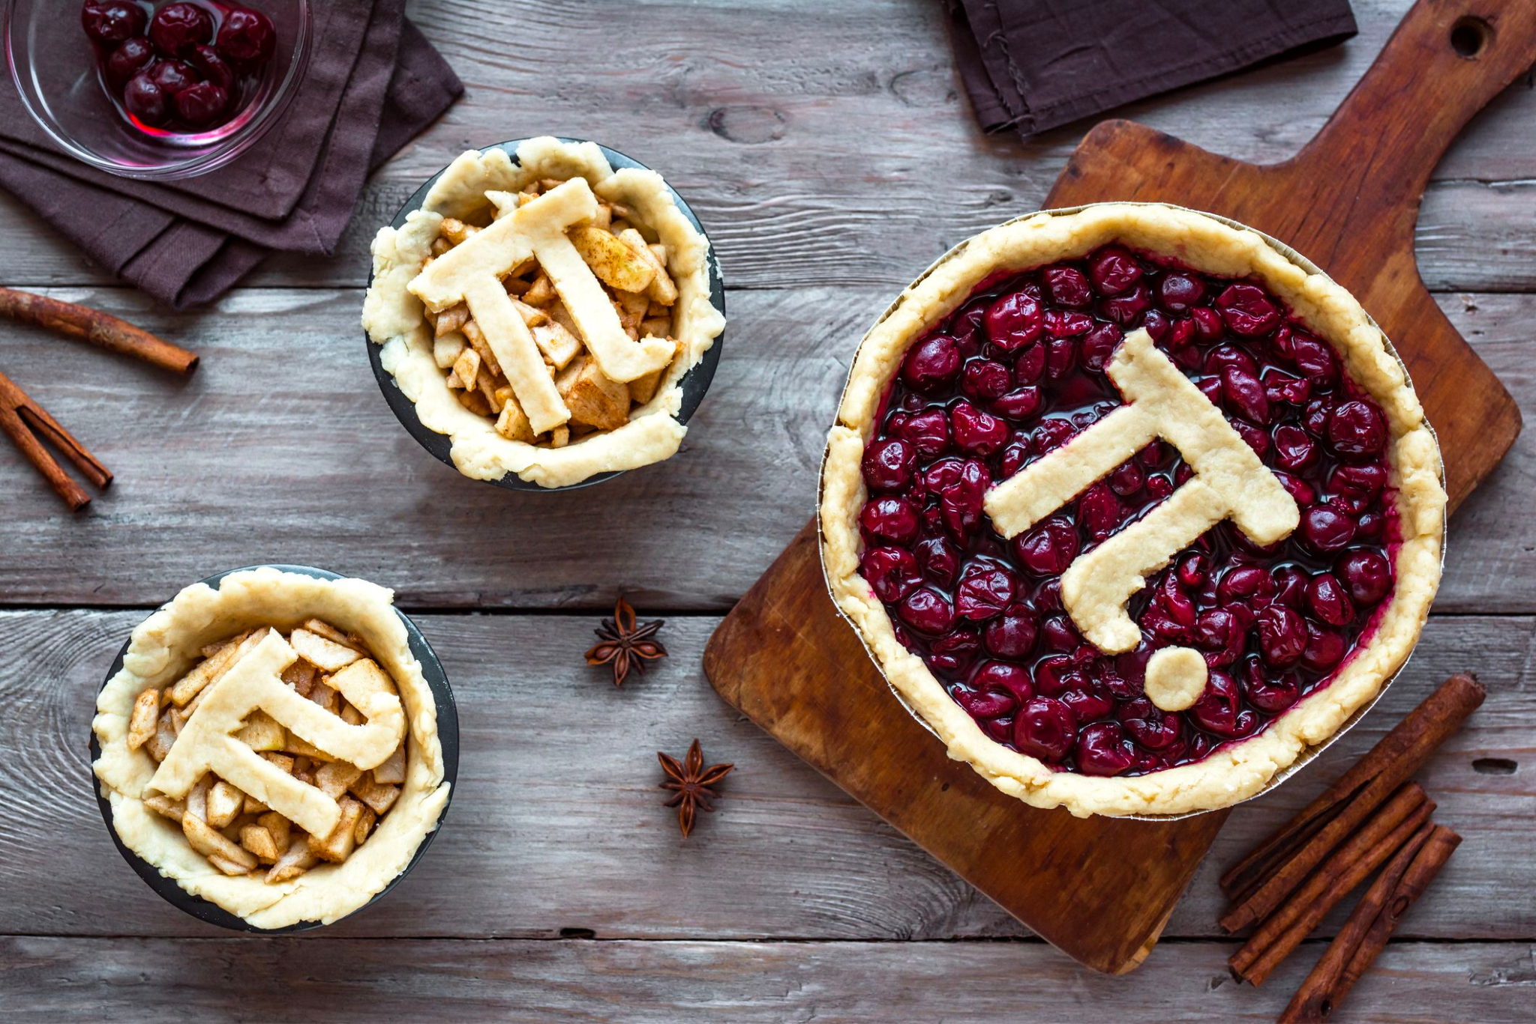
The Bakery
Pie for Pi

Slide 10
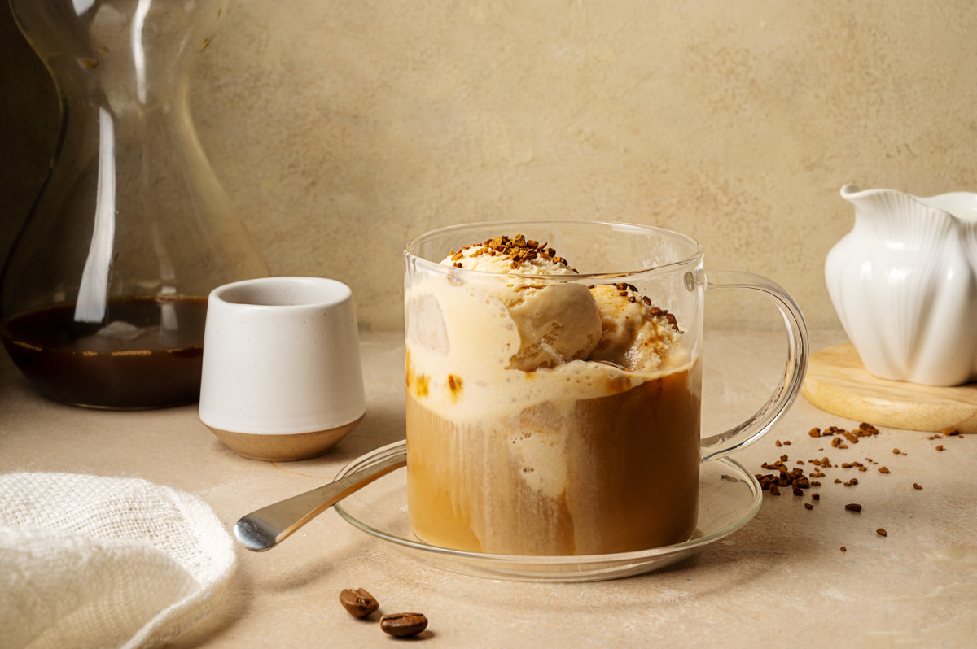
Fibonacci
Collaboration with Fibonacci Brewery
Affogato with Bourbon Creme

