Slide 1
How would I improve Mathemalchemy?
By Ariadne Manor

Slide 2
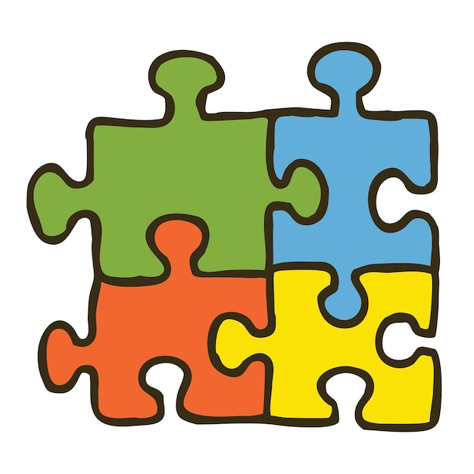
I’m a sociology major
Sociologists study society as a whole everything and everyone is connected

Slide 3

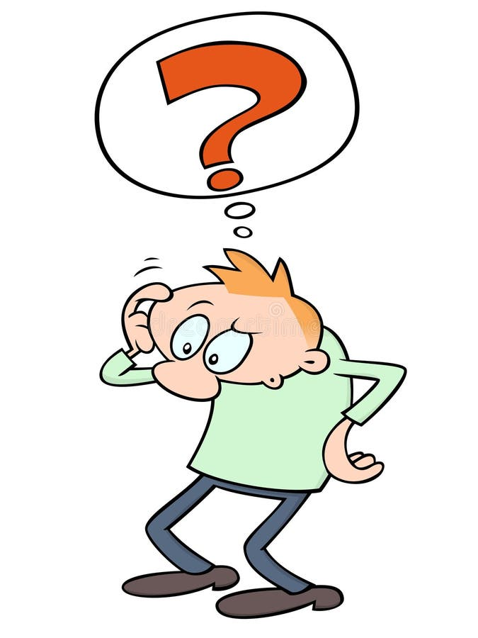
How would I improve mathemalchemy with my major?

Slide 4

My ideas
We should focus on the people, and how mathemalchemy could be used in our day-to-day lives
we as a society should integrate mathemalchemy into the school system

Slide 5
Thank you

