Slide 1
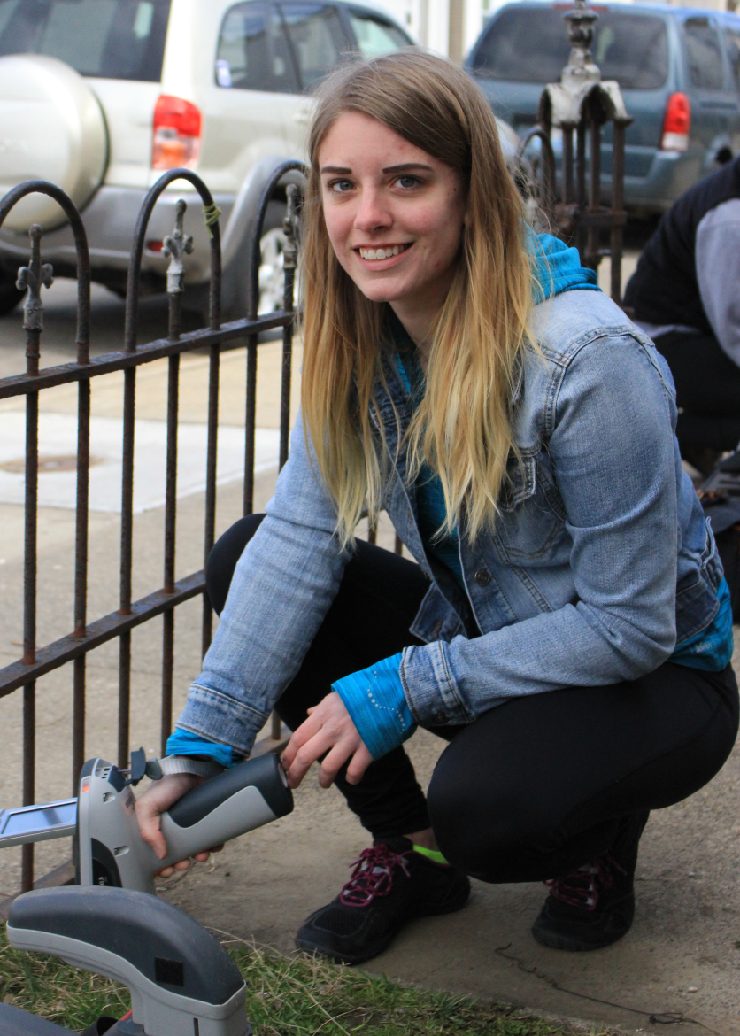
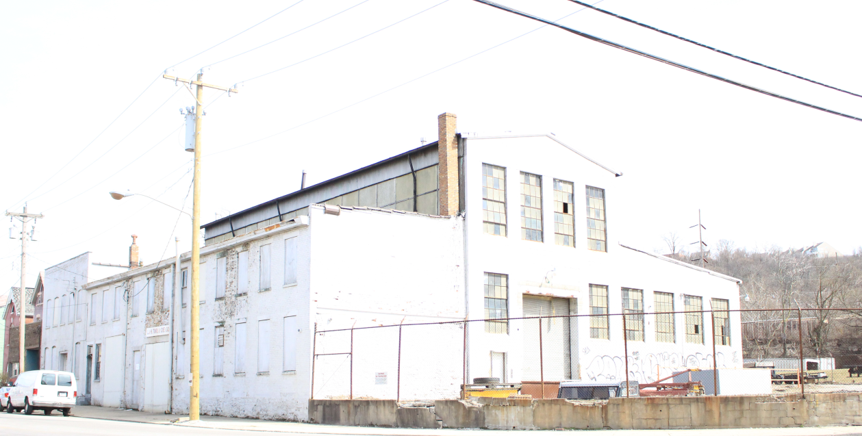
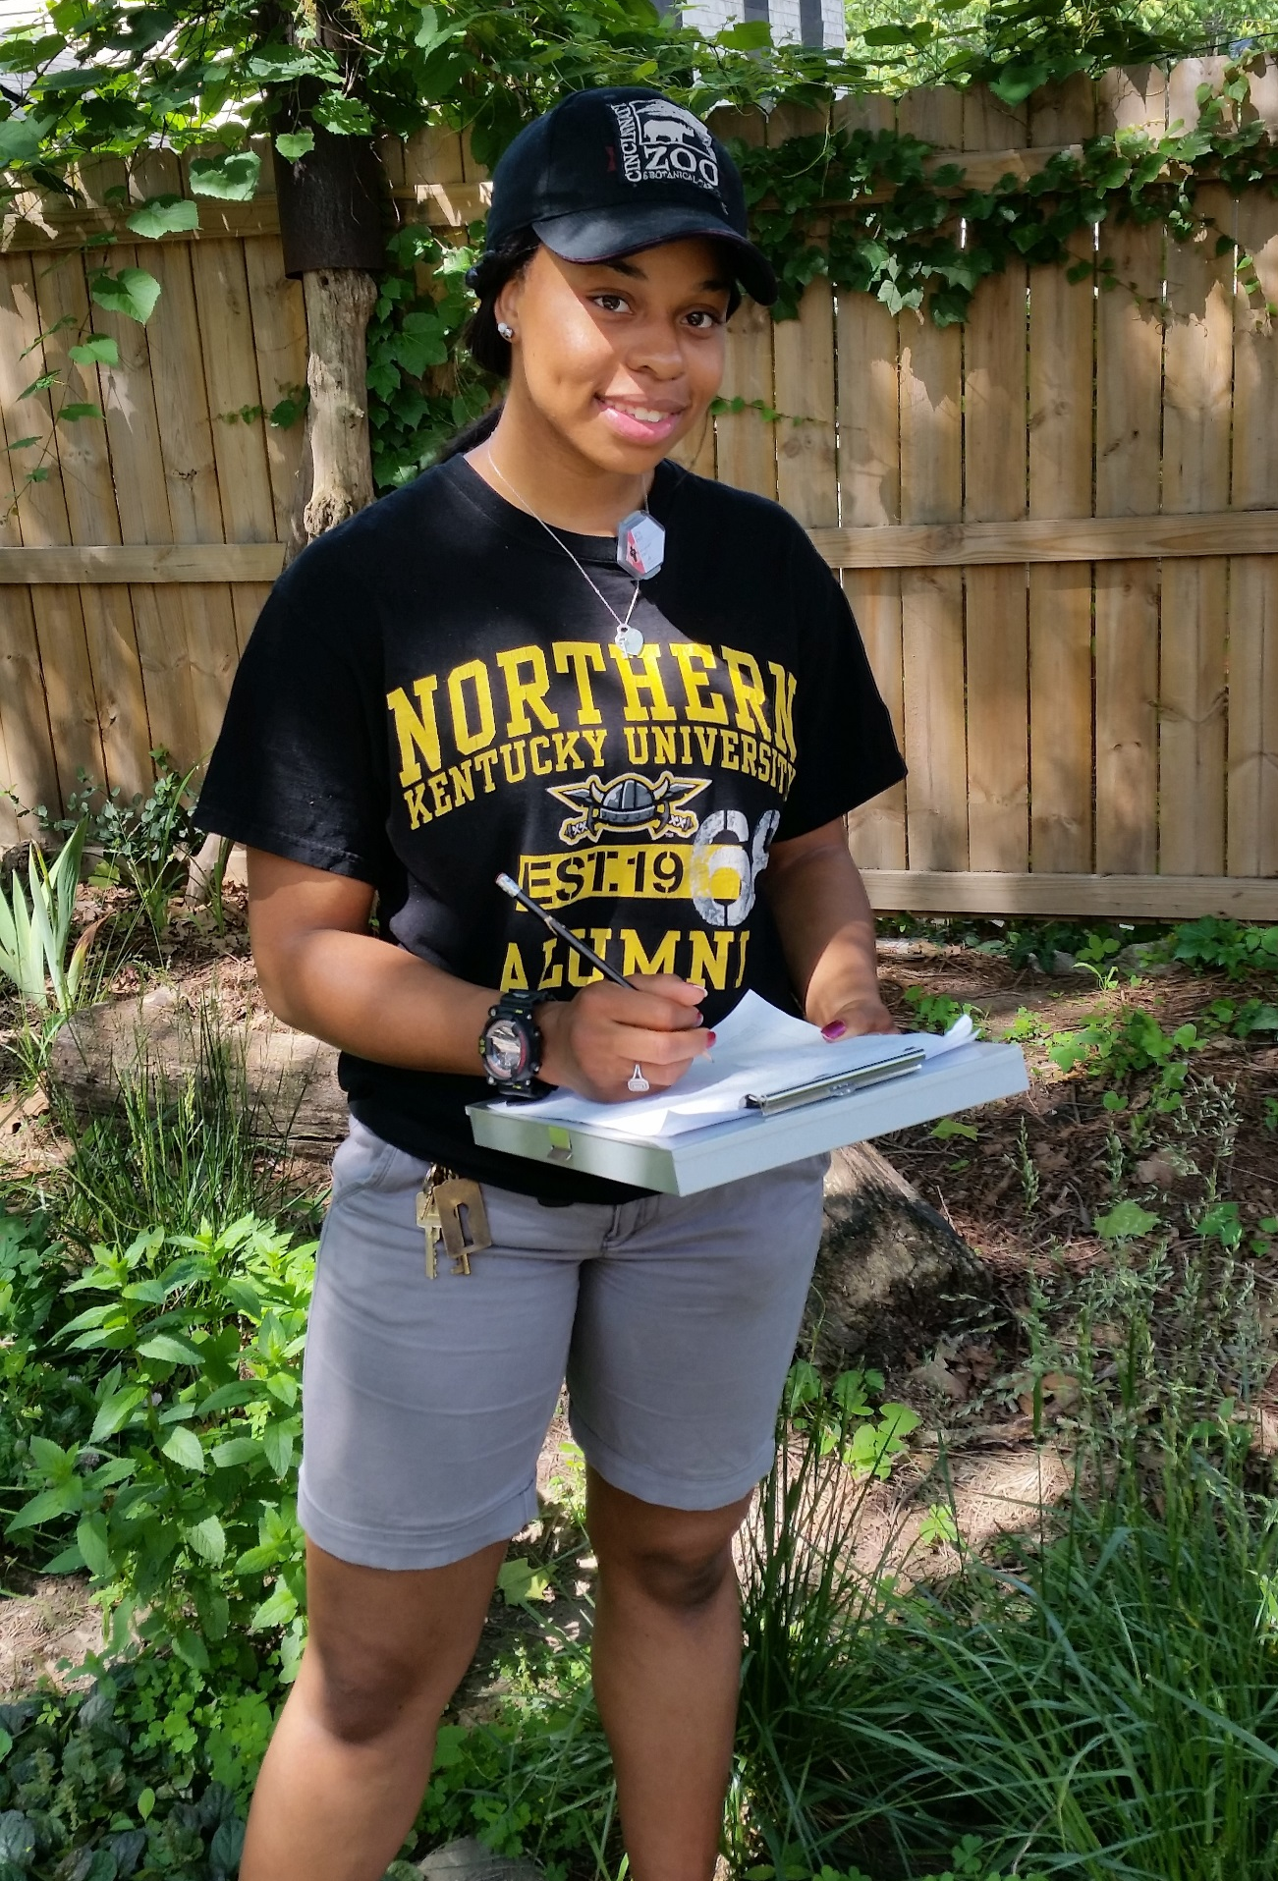
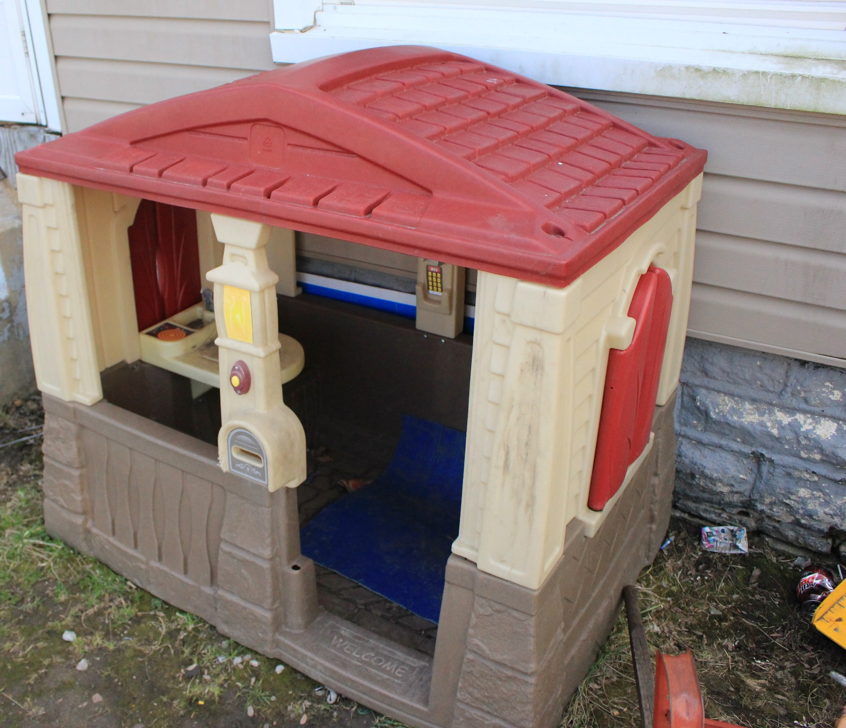
Science storytelling: Soil lead, community, place, and the power of transdisciplinary collaboration
Emily C. Keener, Beth Knox, Kevin Schultz, Sydney Smith, Kirsten Schwarz
Northern Kentucky University, Highland Heights, KY
Soil Lead linked to Ghost Factories
r
A Transdisciplinary Effort
Methods
A 2012 USA Today report titled Ghost Factories investigated the presence of high lead levels in the soil of yards near sites with a history of lead smelting activity around the country. The 14-month investigation revealed high soil lead levels in 21 neighborhoods, including Newport, KY. In Newport, we conducted a follow-up study to the 2012 report focusing on a factory that was identified by the study as a potential source of lead through smelting activities that
Study sites were selected through door to door recruiting and networking with participants living in the direct vicinity and prevailing wind direction of the former factory site. Soil lead concentrations were measured using handheld XRF (x-ray fluorescence) analyzers – the same methodology used in the USA Today study. XRF technology allows us to collect the many samples needed to accurately describe the spatial heterogeneity of soil lead. Our findings are communicated to study participants in the form of spatially explicit maps.
The Ghost Factories project blended science and journalism in order to communicate a hazard in our urban areas. We continued to use this transdisciplinary perspective in our project. Kevin Schultz, the journalism student on this project, did extensive research on the issue of environmental lead. As part of his research he filed open records requests with state and federal administrative groups, interviewed over 20 sources at the community, state, and national level, met with state EPA leaders on the issue of lead, used historical records to learn more about the history of lead in Newport, KY, and met with urban gardeners in the area to discuss how lead contamination affects their efforts to bring fresh produce to an area experiencing nutritional poverty.
Results
Newport, KY data
Lead concentrations for each sample are reported in ppm lead. The EPA recommends that children's play areas do not exceed 400 ppm lead. Additionally, an EPA working group recently suggested that soil used for gardening should not exceed 100 ppm lead. Results are reported for Newport, KY and Cincinnati, OH for regional comparison.
occurred from 1948 to 1954. Smelting can release lead particles into the air, which settle on the soil. Soil acts as a strong reservoir for lead. The follow-up study to the 2012 report was conducted in the residential area immediately adjacent to the former smelter site.
Site | # Tests | # Tests ≥ 400ppm | # Tests ≥ 100ppm | % Tests ≥ 400ppm | % Tests ≥ 100ppm
1 | 20 | 15 | 20 | 75 | 100
2 | 40 | 23 | 39 | 58 | 98
3 | 32 | 12 | 32 | 38 | 100
4 | 24 | 6 | 24 | 25 | 100
5 | 28 | 7 | 28 | 25 | 100
6 | 17 | 4 | 17 | 24 | 100
7 | 22 | 5 | 22 | 23 | 100
8 | 21 | 5 | 20 | 24 | 95
Total | 204 | 77 | 202 | 38 | 99
But, Are the Factories the Culprits?
Cincinnati, OH data
Site | # Tests | # Tests ≥ 400ppm | # Tests ≥ 100ppm | % Tests ≥ 400ppm | % Tests ≥ 100ppm
1 | 22 | 9 | 15 | 41 | 68
2 | 33 | 5 | 12 | 15 | 36
3 | 48 | 22 | 41 | 46 | 85
4 | 33 | 25 | 29 | 76 | 88
5 | 28 | 5 | 21 | 18 | 75
6 | 26 | 8 | 22 | 31 | 85
7 | 16 | 6 | 15 | 38 | 94
8 | 36 | 6 | 18 | 17 | 50
9 | 41 | 3 | 13 | 7 | 32
Total | 283 | 89 | 186 | 31 | 66
Collaborating for Science Communication
Multiple Sources of Lead in Urban Systems
Using a transdisciplinary approach advanced the ultimate goal of effective science communication. Research uncovered by the student journalist informed the soil sampling scheme, and results from the soil testing - along with collaboration among the environmental science and journalism departments - advanced the journalism. This reciprocal relationship provides a compelling justification for transdisciplinary collaboration. The story told from either disciplinary perspective is fascinating, but combined the story is a complex picture of a socio-ecological system told from multiple perspectives, reflective not only of an important environmental and human health concern, but people, place, and community.
We found a greater percentage of sites with soil lead concentrations over 400 ppm and 100 ppm in Newport, KY compared to Cincinnati, OH. However, our findings cannot identify the former smelter site as the main reason for this difference. Lead-based paint and atmospheric deposition from leaded gasoline are also important sources of lead in soil. Future research may focus on the use of lead isotopes and/or element ratios to better determine the source of lead to urban soil.
In addition to industrial sources, leaded gasoline and lead-based paint are historic sources of lead that can contaminate the soil. Lead was added to gasoline from 1929-1986 in order to prevent engine knocking and was added to paint from 1884-1978 as a pigment and to prolong the life of paint. Banning the use of lead in these products has been followed by reduced blood lead levels (BLLs) in children nationally. However, elevated BLLs still remain an issue throughout the country, and soil can be an important source of lead exposure. Elevated BLLs are especially a concern in urban areas where percentages of lead poisoning cases can be much higher than the national average.
Acknowledgements
The authors wish to extend sincere gratitude to the property owners for access to their yards. This project was supported by a 2015 CINSAM Research Grant - “A transdisciplinary exploration of environment: environmental science and communication students dig deeper to explore soil lead contamination in Newport, KY” and NSF award 1337846.

