Slide 1
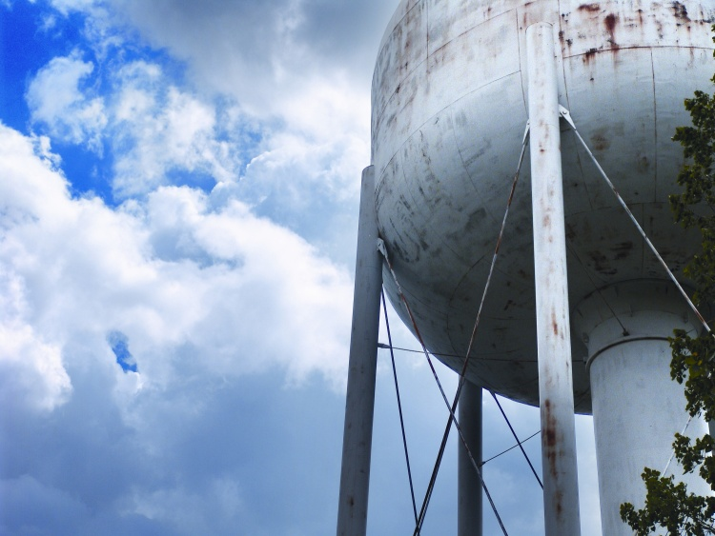
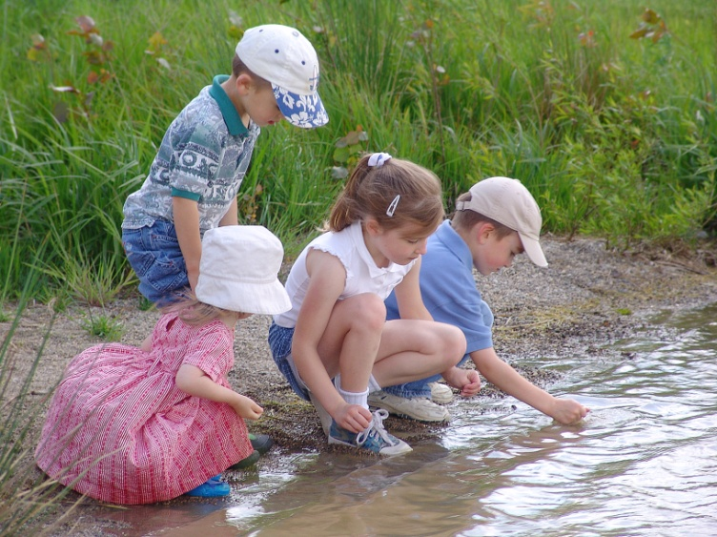
My Career Path in Applied Mathematics
Regan Murray, PhD
U.S. Environmental Protection Agency

Slide 2

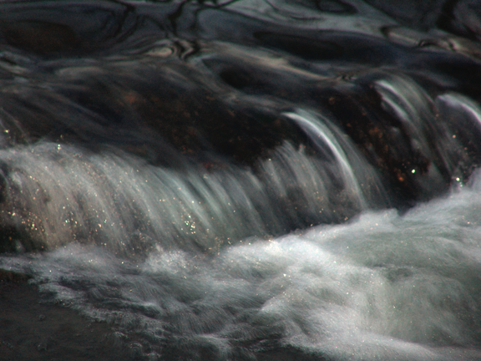
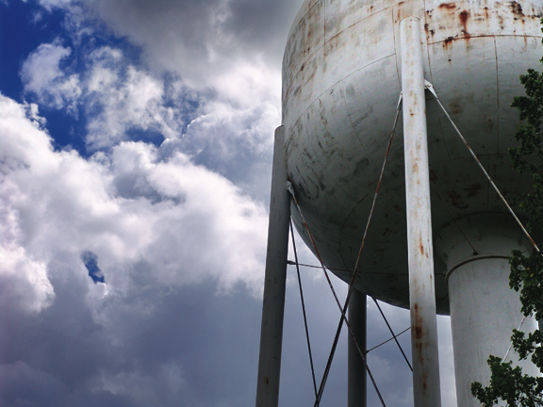
Overview
College and graduate school
Postdoc at Los Alamos National Laboratory
Fellowship with the American Association for the Advancement of Science
Research position with the United States Environmental Protection Agency

Slide 3


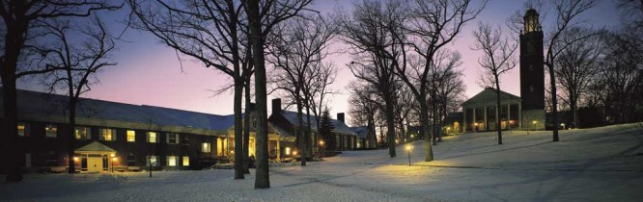
Math major
Environmental Sciences minor
Budapest Semesters in Mathematics
Senior research thesis with Dr. Lisa Holden

Slide 4

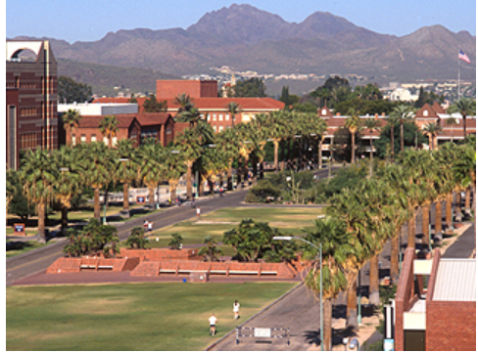
Interdisciplinary Program in Applied Mathematics
  Core courses in Applied Mathematics (Principles of Analysis, Numerical Analysis, Principles and Methods of Applied Math, Case Studies in Applied Math)
  Core courses in Hydrology and Water Resources (Fundamentals of Water Quality, Fundamentals of Subsurface Hydrology, Water Resources Policy, Management, Planning and Rights, Fundamentals: Systems Approach to Hydrologic Modeling)

Slide 5
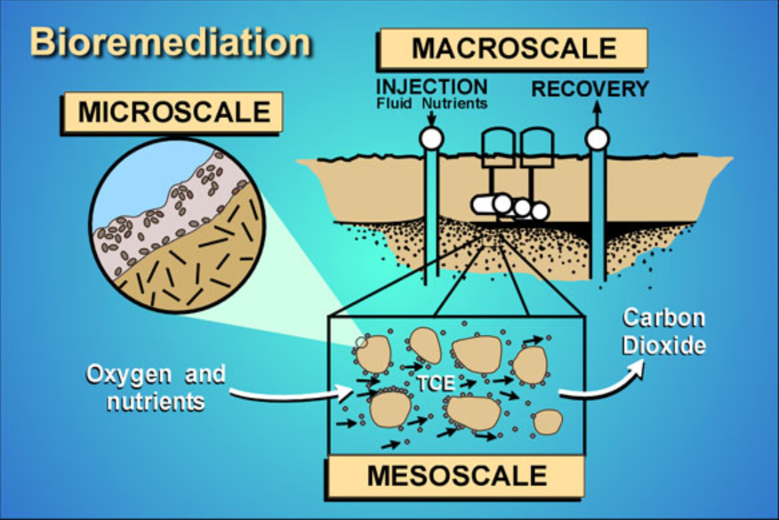
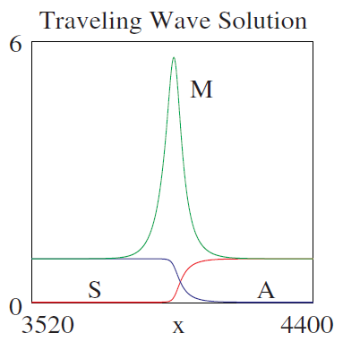
Traveling Waves in a Model for Bioremediation
Bioremediation is a process of encouraging bacteria to consume contaminants in soil
A biologically active zone is created that travels through soil as a wave
System represented by a series of partial differential equations
Proved existence of solutions
Determined parameters that control the width of the BAZ and the onset of oscillatory behavior

Slide 6

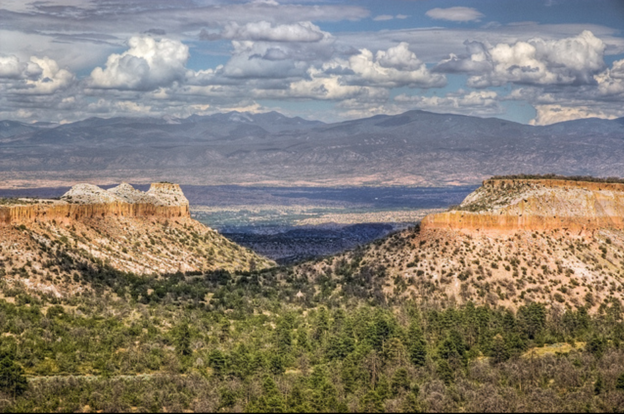
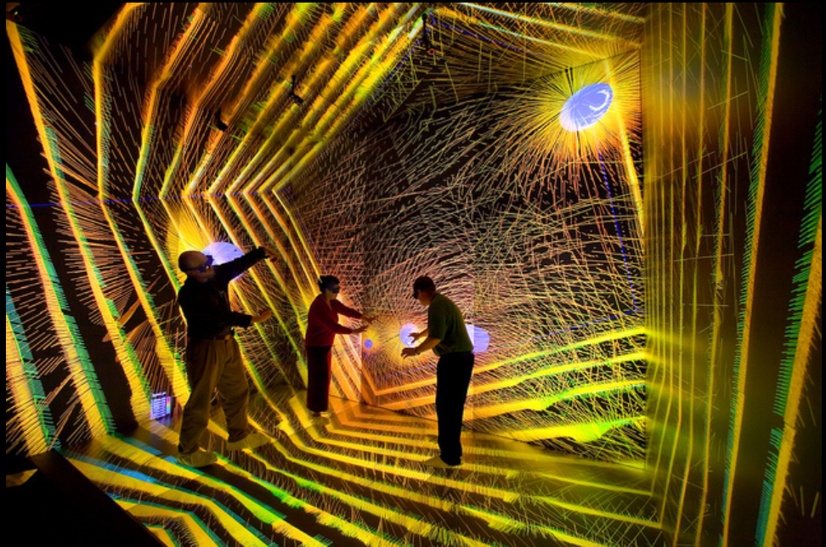
Founded 70 years ago to fulfill one single purpose: to design and build an atomic bomb and end World War II
Today the lab’s work is diverse and addresses a range of issues including:
  Nuclear nonproliferation
  Energy security
  Climate change
  Countermeasures to nuclear and biological terrorist threats
  Partnering with NASA on space missions
I spent two summers at LANL as an intern and then worked as a postdoc

Slide 7
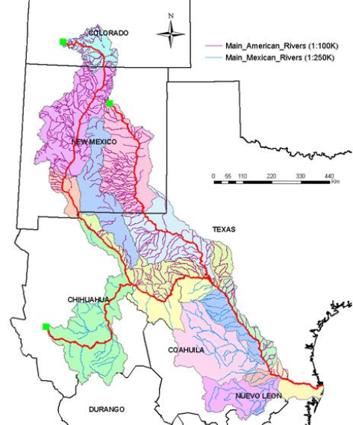
Integrated Modeling Project
  Integrated modeling of the Rio Grande River Basin
  Combined models for atmospheric, surface, and subsurface waters
  Focused on boundary conditions to connect data at different spatial and temporal scales
  Worked with researchers from several universities and national lab

Slide 8


Science Policy Fellowship Program in Washington DC provides opportunities to PhD’s to:
  Contribute knowledge and analytical
  skills to the federal government
  Learn first-hand about policymaking
  and implementation at the federal level
  Build S&T leadership equipped to
  address complex societal challenges
Fellows can be placed in Congress or at a federal agency
  Placed at the United States Environmental Protection Agency’s Office of Research and Development

Slide 9
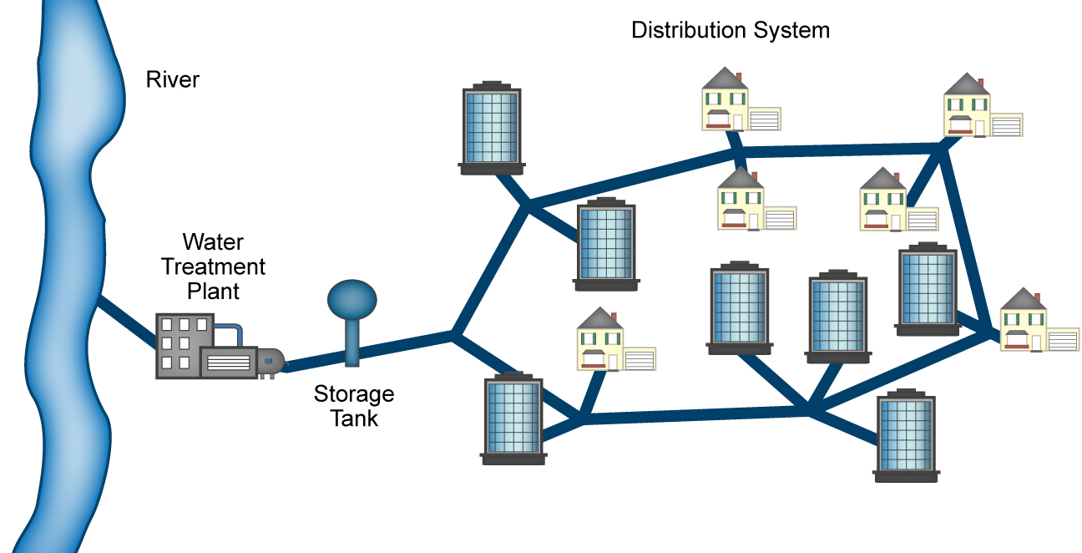
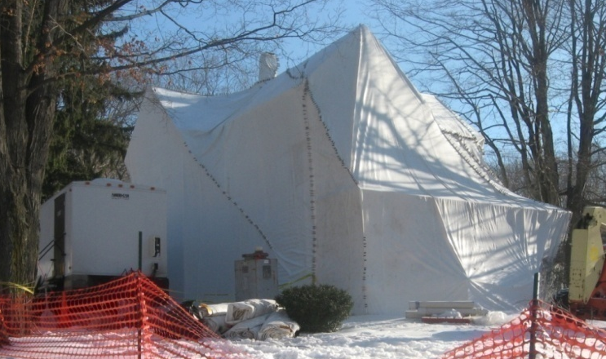
Threat Ranking for Prioritization
EPA’s homeland security / all hazards responsibility includes protecting water systems, cleaning up after events, and assessing risks
Developed potential threat scenarios
Formulated list of potential targets
Estimated consequences
Ranked scenarios according to:
  Risk = Threat * Vulnerability * Consequences
Also solicited expert judgment
EPA used analysis to prioritize research and technical support activities

Slide 10

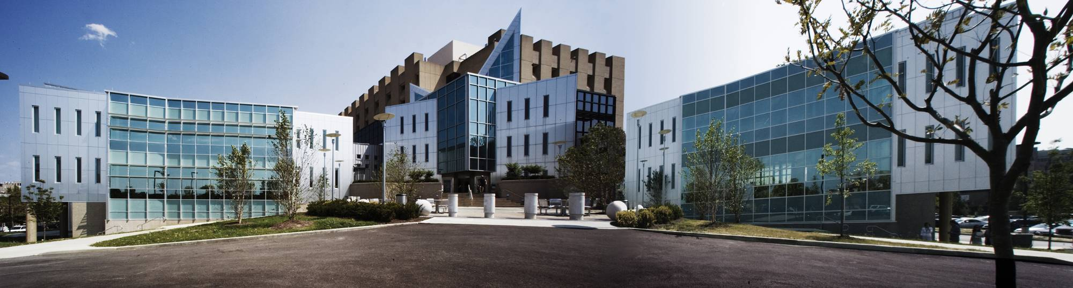
U. S. Environmental Protection Agency
In 1970, the White House and Congress worked together to establish EPA in response to the growing public demand for cleaner water, air, and land
With more than 17,000 employees across the country, EPA researches, develops and enforces regulations that implement environmental laws
  Taking Action on Climate Change
  Improving Air Quality
  Assuring the Safety of Chemicals
  Cleaning up our Communities
  Protecting America’s Water
  Environmentalism and Environmental Justice

Slide 11
10 Ways EPA Has Strengthened America
Banning widespread use of DDT
Removing the acid from rain
Rethinking waste as materials
Removing lead from gasoline and the air
Clearing secondhand smoke
Vehicle efficiency and emissions controls
A cleaner environment for all
Managing toxics
Cleaner water
Public information and community right to know
The Aspen Institute
http://www.aspeninstitute.org/sites/default/files/content/docs/events/EPA_40_Brochure.pdf

Slide 12
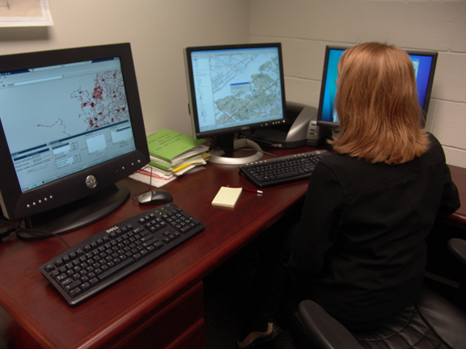
EPA is using mathematics to improve water quality, security, & sustainability
Mathematical approaches
  Differential Equations
  Statistics and data mining
  Optimization
  Modeling and Simulation
  Computational techniques
Software tools to design and evaluate mitigation technologies
Automated control systems
Improve basic understanding of physical, chemical, biological processes

Slide 13
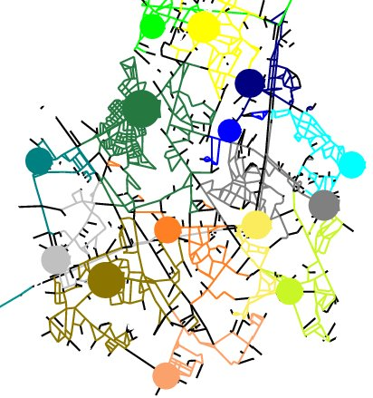
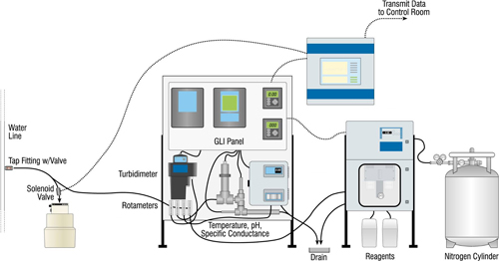
Sensor Placement in Drinking Water
Sensor stations cost $20,000+
Only indirect sensors available
Water systems have multiple points of access and are spread over thousands of miles of pipes
Met with water systems to solve problem
Formed interdisciplinary research team
Formulated optimization problem
Tested solutions on computer and in field
Developed user friendly software to allow water utilities to solve the problem themselves

Slide 14
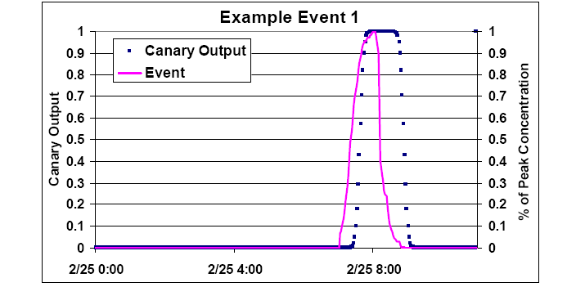
Sensor Data Signal Processing
Water quality sensor data noisy with diurnal patterns
Can we distinguish between normal variability and possible contamination incidents?
Investigated statistical approaches, data mining and data fusion methods, and pattern matching techniques
Met with water systems to solve problem
Tested solutions on computer and in field
Developed user friendly software to allow water utilities to solve the problem themselves

Slide 15
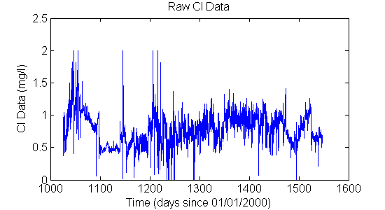
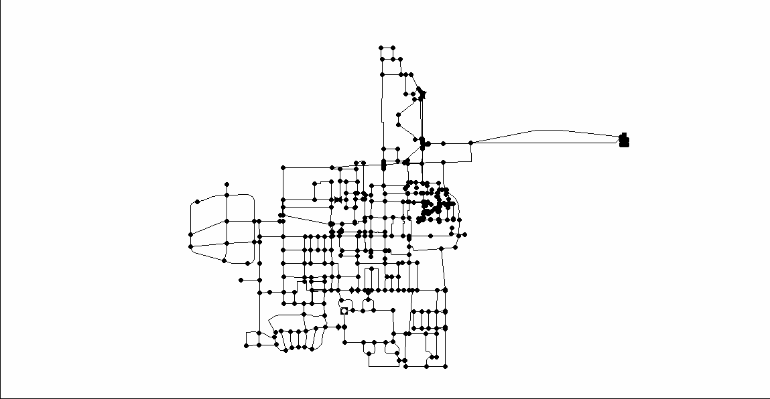

Real-world Detection Strategies
Noisy Data
CANARY Analysis
Distribution Network
Sensor Station
CANARY ALERT!
Consequence Management Plan

Slide 16
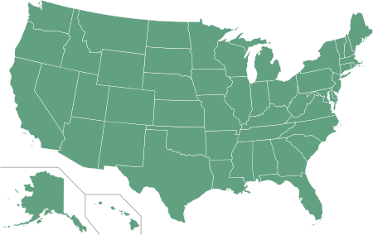

SPOT and CANARY Applications
  San Francisco
  Los Angeles
  Avondale, AZ
  Dallas
  Arlington, TX
  Palm Beach, FL
  Cincinnati
  Ann Arbor
  New York City
  Philadelphia
Recognized by R&D Magazine as one of the 100 most significant new technologies of 2010!

Slide 17
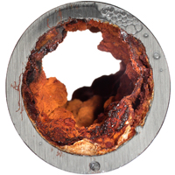
Advanced Water Quality Modeling
Complex chemical, biological and physical processes in water pipes
Accurate models of contaminant reaction kinetics are needed in order to predict fate and transport and assess decontamination feasibility in water pipes
Experiments are conducted to measure behavior under specific circumstances
Models are developed, validated, and then applied to answer broader questions
Pf
FLOW
Pb
Pd
d
attachment
detachment
Xf
Lf
l
bulk
Pd
Pb
Lbl
Pw
detachment
adhesion
Lf
Schematic of pipes showing pipe wall layer where contaminants can adsorb to corrosion products or attach to biofilms

Slide 18
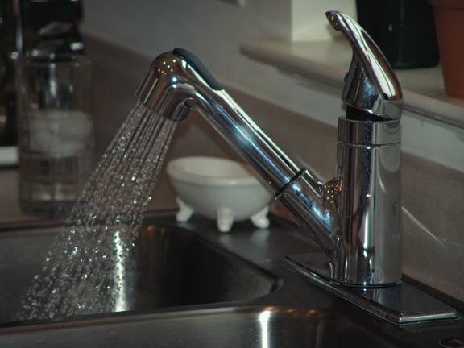
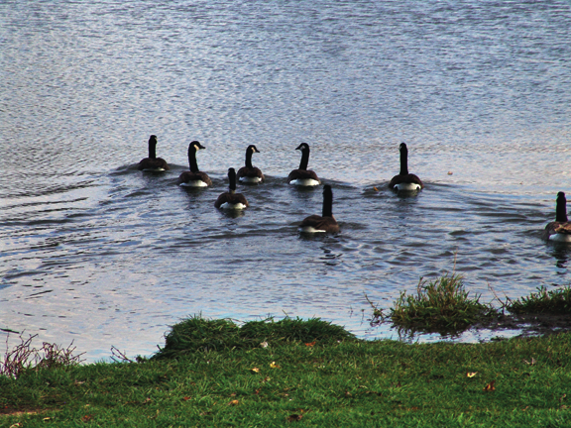
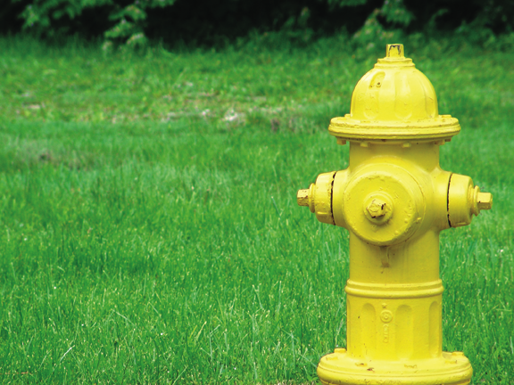
Our Nation’s Drinking Water: A Precious Resource
Notes:
**All of us are impacted by the quality of our Nation’s drinking water, when we drink from the tap, cook, bathe, make coffee at home, or even buy it from the corner coffee shop.
**Water is a precious natural resource that is critical to maintaining public health, fighting fires, and the daily operation of many industries.
**Before 9/11, many Americans took the security of our Nation’s drinking water for granted. Recognizing the possibility of well-organized and well-financed terrorist attacks in the U.S., the EPA is developing new strategies to ensure not only the quality of our Nation’s water supply but also the security.

