Slide 1
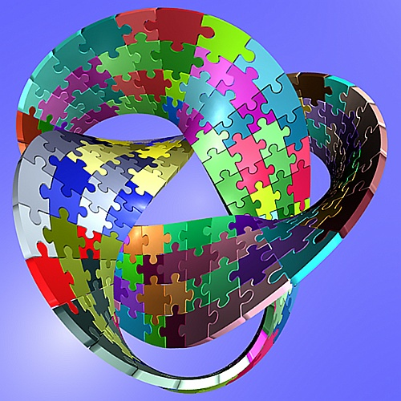
BARBOUR KLAN
Art, Geography, Science
MATH
Mom, Marc, Anna & Alice
ME
DAD
MOM
ANNA & ALICE
MARC
CRAIG
TRACI
DO IT AGAGIN !!
N0 MATH
Me, Traci , Craig and My Dad
History, English, Band

