Slide 1
HOW TO SAFELY BOX AND SHIP PINNED INSECTS

Slide 2
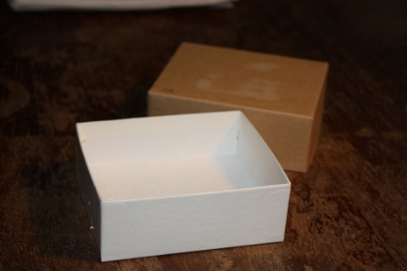
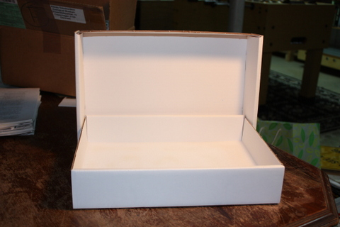
Pinning Boxes
(available from BioQuip: www.bioquip.com)
For smaller numbers of specimens
For larger numbers of specimens
Unit tray shipper with polyfoam insert
Cat. No. 1025BX
Folding insect box
Cat. No. 1002F or 1002FX

Slide 3
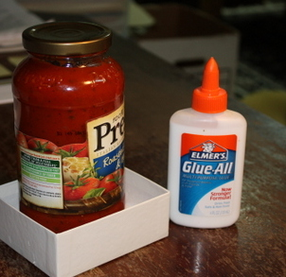
Before adding specimens – check bottom of pinning container!
Sometimes the foam bottom is not adequately glued down (small) or not glued in to begin with (large)
If this is the case:
  Coat bottom with glue
  Add foam pinning layer
  Add weight
  Allow to dry

Slide 4
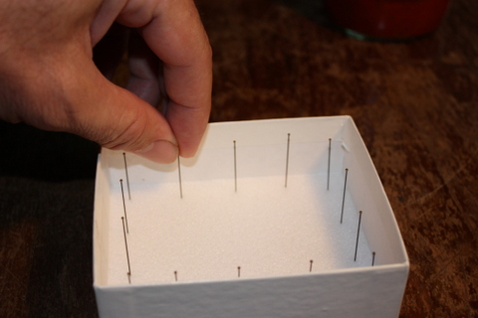
Place support pins around outside

Slide 5
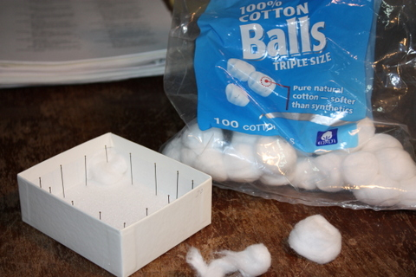
Pin ½ cotton ball in one corner
Used to capture a head or leg or other body part if it falls off during shipping
Light parts of insects tend to lodge in the soft cotton fibers
May be possible to associate part with specimen

Slide 6
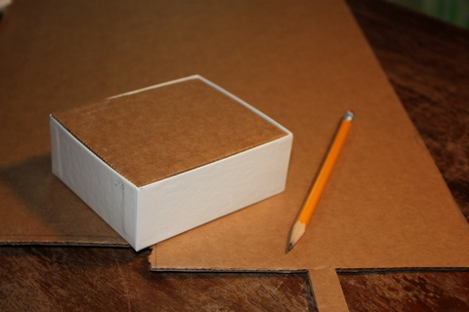
Cut cardboard inner lid
Set the pinning box upside down on a piece of corrugated cardboard
Draw shape with pencil
Cut out cardboard – should be just slightly smaller than outer edge of box

Slide 7
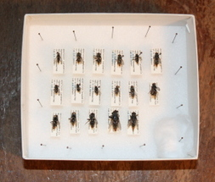
Add specimens
Do not pin “densely”
If open space remains in box, add some support pins to fill the space

Slide 8
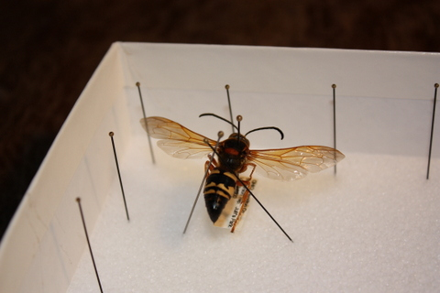
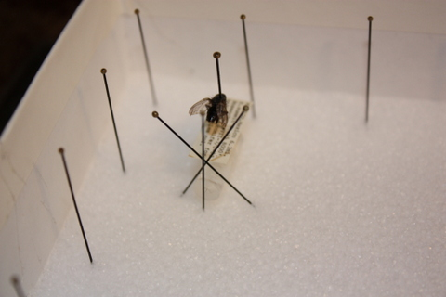
Make sure that specimens are securely pinned
If specimens are long and may swivel on pin – add support pins
If specimen has an attachment (like genitalia vial) – add support pins
Straight along sides or an inverted “V”
Inverted “V” with straight up pin at end

Slide 9
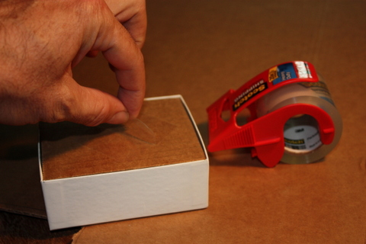
Add cardboard inner lid
Gently set cardboard inner lid on top of specimens
Make sure lid is stable and fits well inside pinning box
If necessary, add extra support pins in empty areas of pinning box
Fold a piece of tape to make a “handle” for easy removal of inner lid

Slide 10
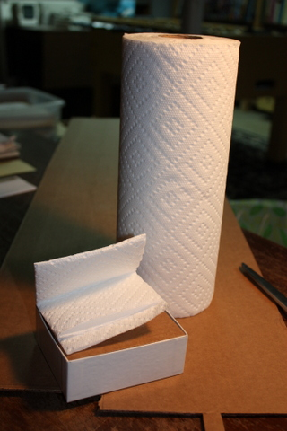
Add filler to top of insert
You want to make sure that the space between the cardboard insert and box lid are filled
Use folded paper towel or piece of bubble wrap to fill space

Slide 11
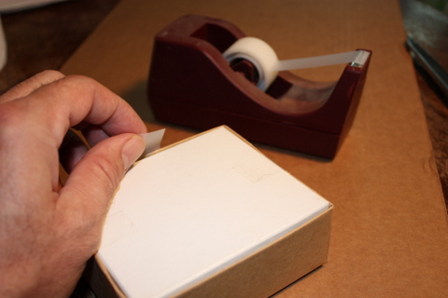
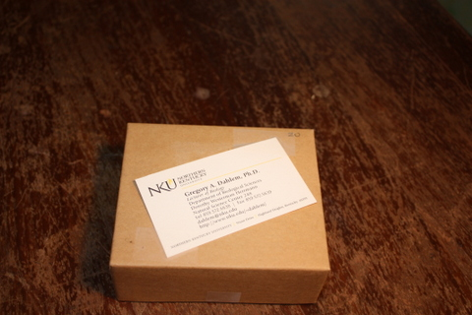
Add lid and label
Tape lid so it is securely shut
Add business card or address label to top of container

Slide 12
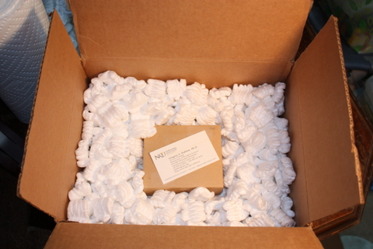
Put pinning box into shipping box half filled with foam “peanuts” – make sure you have at least 2 inch margins on all sides (sides and top/bottom)
>2”
>2”

Slide 13
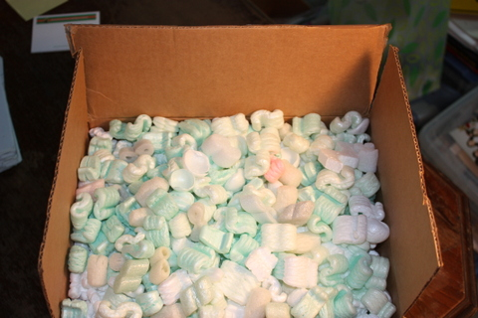
Fill box to just over rim with foam peanuts
When you close and tape down lid, you should have to
smash down the peanuts just a bit to get lid to close

Slide 14
Tape, label, and ship
Remove all old labels and mark out any old printed addresses or info if you are re-using a cardboard shipping box
Tape the box well with good quality shipping tape or strapping tape
You may want to wrap box in brown shipping paper, especially if old box has lots of markings on it
Use red ink marker to write “Fragile” on several sides of box (or use stickers labeled “fragile”)
Include both return address and shipping address on front
Mail package. USPS Priority Mail usually cheaper than UPS or other shipping companies – I usually pay the little extra for tracking

