Slide 1
Conducting a Successful Search
September 2015

Slide 2
WHAT IS INCLUSIVE EXCELLENCE?
VISION AND A PRACTICE where diversity, equity, and inclusion are reframed as vital to institutional excellence.
ORGANIZATIONAL CHANGE PROCESS that leads to
OUTCOME of institutional excellence whereby, students, faculty, and staff, with varying backgrounds, cultures, and mindsets, can flourish through learning, advancement, and meaningful engagement in institutional life.

Slide 4
Confidentiality

Slide 5
DEFINING THE POSITION
Language for position description – what is important?
Language that will attract diverse candidates
Approval process

Slide 6
SEARCH COMMITTEES
Diversity of the Committee
Charge
Duties

Slide 7
DEFINITION
Diversity - individual differences (e.g., personality, learning styles, and life experiences) and group/social differences (e.g., race/ethnicity, color, class, gender, disabilities, sexual orientation, gender identity, gender expression, age, country of origin, and ability as well as geographical, cultural, political, religious, or other affiliations, and discipline.

Slide 8
RECRUITMENT
Posting sites
Cohort hiring
Networking - the key to building an exemplary applicant pool is personal contact

Slide 9
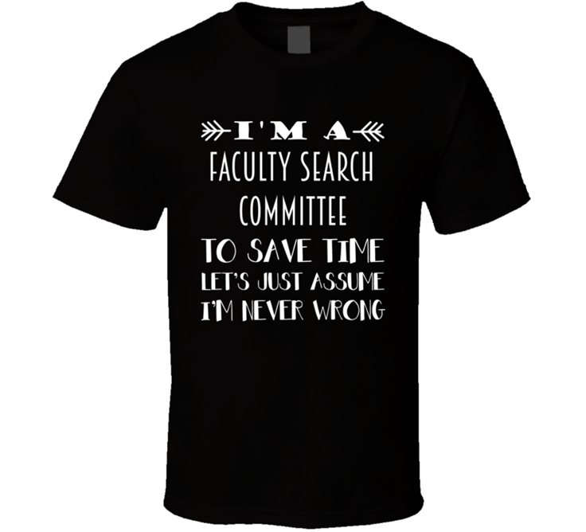
SCREENING, EVALUATION & INTERVIEWS
Initial screen
Evaluation
The whole process is an interview – first contact, airport/hotel pick-up, walking between interviews, meals etc.
Approval of candidates

Slide 10
Through each step of the process…
Creating a sense of hospitality and inclusiveness
Inclusion is leveraging the diversity of our students, faculty, and staff to achieve full participation and optimum performance through intentional and proactive inclusive practices that make people feel like they belong and are actively valued. It is about empowerment and engagement.

Slide 11
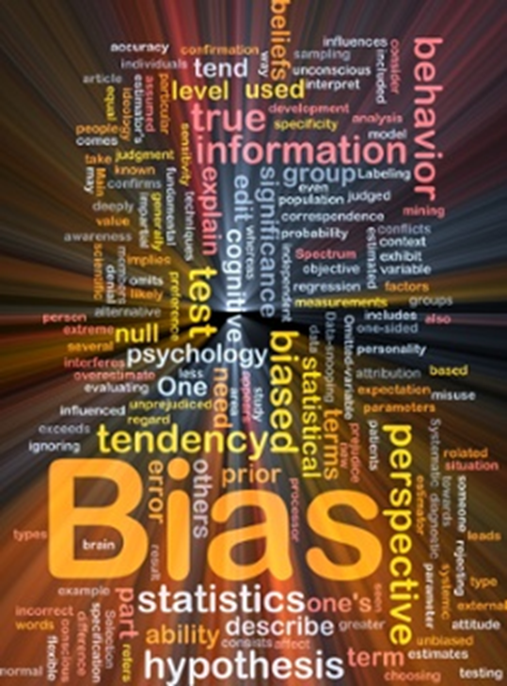
Through each step of the process…
Watch for Implicit Bias

Slide 12
What do you see?

Slide 13
Complete these sentences
Ca y u rea th s? You a e not r ading th s! At ar ou rea in?
Notes:
DM

Slide 14
UNCONSCIOUS BIAS
Unconscious biases are the result of our limited cognitive capacity; we implicitly and automatically both group and categorize people to avoid having to conduct completely new assessments for every new person.
Unconscious biases are our unintentional people preferences, formed by our socialization and experiences, including exposure to the media. We unconsciously assign positive and negative value to the categories we use.
Wi-fi: what we see together, we wire together.
Automatic and rapid
We do not have to believe a stereotype for it to affect us.
Often in our personal ‘bias blind spot’
Pervasive, and we ALL have them
Resistant to change and creates ‘special’ categories.
Lead to ‘micro-behaviors

Slide 15
10 THINGS WE CAN ALL DO
1. Recognize our own vulnerabilities: our traits and people biases
2. Recognize the contexts when our biases may be most active
3. Recognize that we are reinforcing biases
4. Have the ‘honest conversation’
5. Schedule demanding emotional or cognitive work away from people decisions where possible
6. Watch our micro-behaviors and try to re-balance them
7. Assume bias will be at play, pause and think
8. Stop suppressing and depleting our natural inhibition process
9. Stop asking people to be constantly alert all of the time
10. Stop rushing with some groups at some times

Slide 16
LINKS
The Danger of a Single Story: https://www.youtube.com/watch?v=D9Ihs241zeg
Implicit Associations Test: implicit.harvard.edu
Dateline Segment-IAT: https://www.youtube.com/watch?v=n5Q5FQfXZag
Neuroscience of Implicit Bias: http://facultyhiring.uoregon.edu/special-concerns/
Search Committee assistance - http://hr.nku.edu/toolkit/emplymt.html

Slide 17
OFFER
DOCUMENT DOCUMENT DOCUMENT
Sample documentation
Summary of search process
Justification of chosen candidate
Official offer must come from Provost

Slide 18
INTEGRATING NEW FACULTY
Onboarding
Creating a culture of inclusiveness

