Slide 1

Organic Chemistry CHE 310-002
KC Russell
SC 305; 859-466-3528

Slide 2
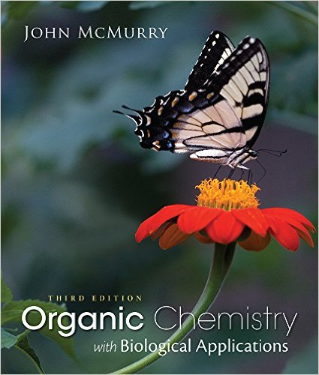


Required Materials

Slide 3

Recommended Resources
Office Hours
Supplemental Instruction
STEM Sessions
http://www.nku.edu/~russellk/courses/chm310/310.htm

Slide 4
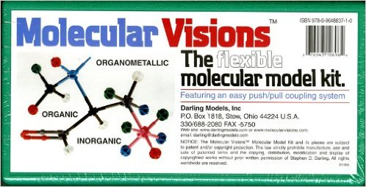


Recommended Resources

Slide 5
Grading
540 Total Points
Daily Quizzes 45
OWL Homework 45
Semester Exams 300
Final Exam 150
A (≥ 86.00%) A- (83.00 – 85.99%)
B+ (80.00 – 82.99%) B (76.00 – 79.99%)
B- (73.00 – 75.99%) C+ (69.00 – 72.99%)
C (64.00 – 68.99%) C- (60.00 – 63.99%)
D+ (55.00 – 59.99%) D (50.00 – 54.99%)
F (≤ 49.99%)

Slide 6
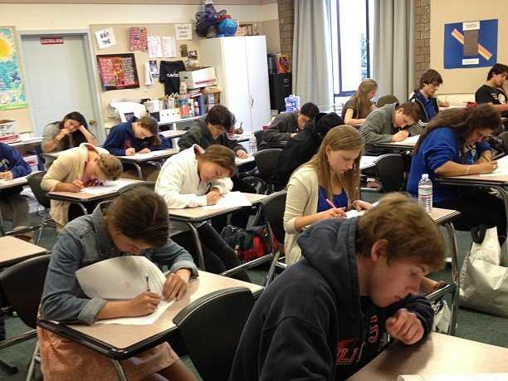
Out of Class Exams
Exam 1 – September 30th, 2:30 – 5:30 PM, room SC 201
Exam 2 – Rocktober 28th, 2:30 – 5:30 PM, room SC 201
Exam 3 – December 2nd, 2:30 – 5:30 PM, room SC 201
Notes:
when to show up, no make-ups

Slide 7



Classroom Etiquette

Slide 8


Communication

Slide 9
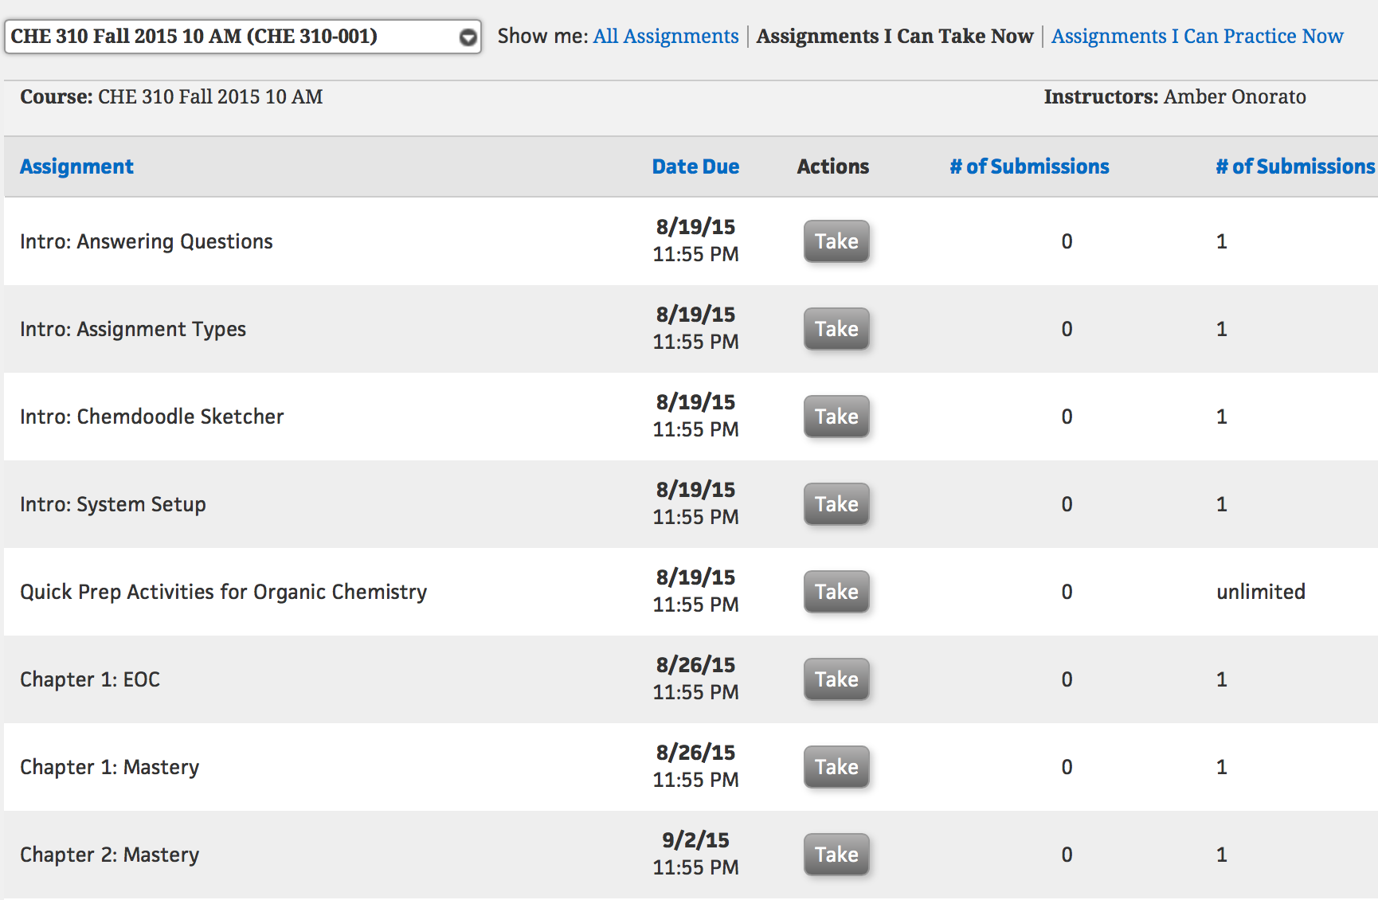
OWL Homework
Due on select Wednesdays at 11:55 PM – NO EXTENSIONS
Notes:
already open. Only 4 attempts.

Slide 10
A quiz a day helps keep poor grades away?
"It helps you figure out where you're getting stuff wrong, where you're getting stuff right"
"I realize I have to study and learn the material day by day, It's helped me spread out my studying more, and there's less cramming that I do."

Slide 11

A quiz a day helps keep poor grades away!
EVERY Lecture
Worth 4 points
Written or Clicker
No Make-ups
Q = 50 x (your total quiz points/ total possible quiz points).
Notes:
if forget clicker is a zero.

Slide 12
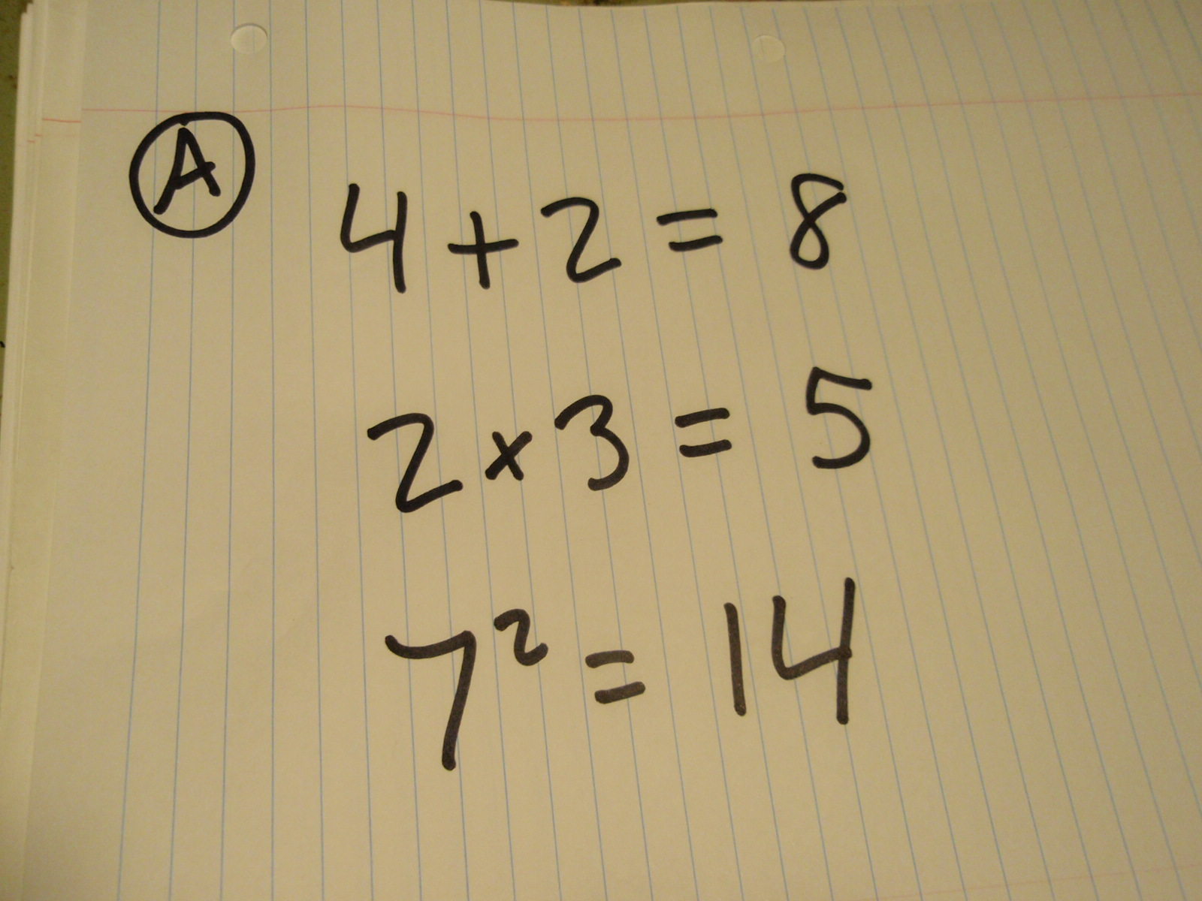
Re-Grade Request
Written request must be submitted within two working days of when graded material is returned in class
Needs a clear explanation of what you believe is graded incorrectly
Anything in pencil or erasable ink will not be re-graded.
Must use the on-line re-grade form

Slide 13

Disability Services

Slide 14
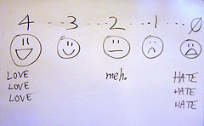
Student Evaluations
Student evaluations are regarded as strictly confidential.
Students who complete an evaluation are rewarded for their participation by having access to their course grade as soon as it is posted.
Thorough feedback, whether positive or negative, is more useful.
All evaluations are read by other faculty besides the instructor.

Slide 15

Mastery of Content
Organic Chemistry
As a student in this course, you are expected put forth a great deal of effort and to take responsibility for your learning. However, grades are based on performance, not effort. Although hard work is admirable, it is not what will determine your grade. Instead, your grade will be based on your mastery of course objectives.

Slide 16
